Slide 1
Stream Processing Design Patterns How we Deliver an Exceptional Personalization Experience to Customers at Capital One
Andreas Markmann
Manager, Data Engineering
Enterprise Customer Intelligence (ECI)

Slide 2
Outline
Delivering streaming data to where it’s needed
Frustrations with customer support
Stateless filters / enrichments - but no aggregates or joins
Recent interactions
Internal state
External state
Data locality
Deploying in production: failure tolerance
Consumers use heuristics to bridge rescheduling / restart pauses
At-least once vs exactly-once
Exactly-once vs idempotent
Real-time alerting
Losing sales due to being unprepared for sudden interest
Windowing: not quite real-time
Real-time updates and extrapolation
Conclusion
Streaming Patterns Cheat Sheet!

Slide 3



A Frustrating Customer Experience
“Let’s start over, what were you trying to do?”
<click>
<click>
<click>
What now?
?
Notes:
Customer just interacted with us through our web page - why can’t we know how to help them?

Slide 4
A Frustrating Customer Experience
“Let’s start over, what were you trying to do?”
“Let me transfer you to my colleague”
Notes:
Transfer to other support staff

Slide 5
A Frustrating Customer Experience
“Let’s start over, what were you trying to do?”
?
Notes:
Can lead to restart of conversation - why should that be necessary?

Slide 6
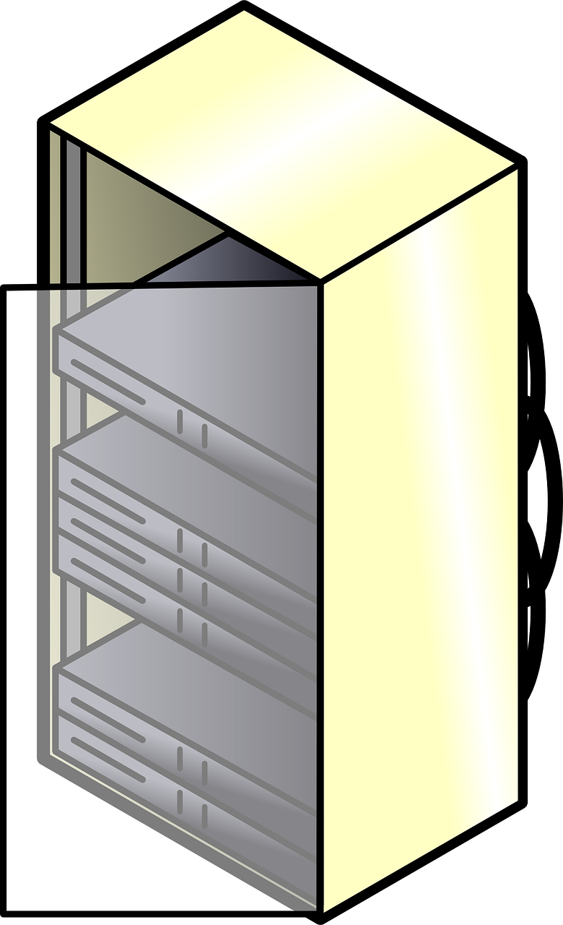
A Simple Example: Delivering Customer Interactions to Where They are Needed
“Here is more information that will help you…”
Data enrichment – add context to customer interactions → stateless processor
+ info
Notes:
A simple imaginary streaming application - add helpful URL to interaction

Slide 7
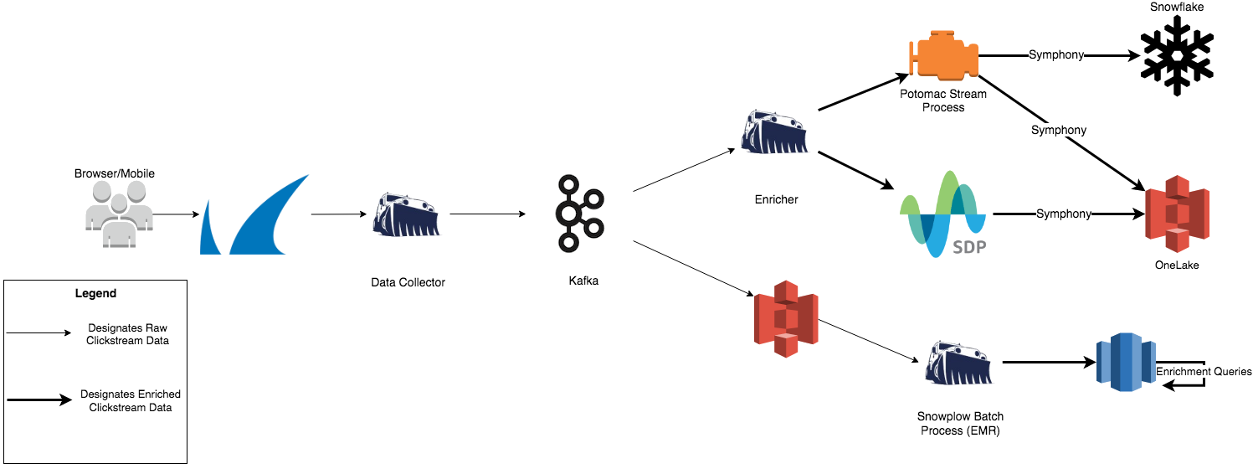
Simplified Ingestion

Slide 8
Stateless Processing
Simple mapping, e.g. remove sensitive information
Filter, e.g. deliver only relevant data
Enrichment, e.g. add data from lookup to each message
Note that windowed join and reduce are stateful aggregates!
Basic transformations: map, filter, reduce (fold), union, join.
bit.ly/simple-transformations
Filter, Map, Split, Union
Position in input stream
1
0
1
1
0
1
1
0
0
0
1
0
1
1
0
1
Latency
Memory Usage
Throughput
Output stream

Slide 9

Stateful Streaming Application Example
“I get what you are doing. Want me to help with the next steps?”
Storing and retrieving multiple recent interactions → stateful processor
Store
Notes:
A more realistic application - recent interactions

Slide 10

No Need to Call – Everyone Gets a Personal Assistant
“Here are some options for what you are trying to do: …”
Storing and retrieving multiple recent interactions → stateful processor
Store
Notes:
Automating this for all customers enables personalized assistants for every customer at lost cost

Slide 11
Internal State
Note that windowed join and reduce (aggregation) are stateful!
May require shuffle to co-locate current record and its state → latency
Internal state may be queriable via API depending on framework
1
0
1
1
0
1
1
0
0
0
1
0
1
1
0
1
Latency
Memory Usage
Throughput
Notes:
Internal state: easy to implement but tied to processor

Slide 12
External State
To keep memory usage low and throughput high, use asynchronous connections and limited pool of connector objects
Can lead to very out-of-order outputs!
High network load reduces throughput in network-bound processors
1
0
1
1
0
1
1
0
0
0
1
0
1
1
0
1
Latency
Memory Usage
Throughput
Redis
RocksDB
DynamoDB etc

Slide 13

Data Locality with External State
May require shuffle to co-locate current record and its state → latency
Pre-sort data in producer to reduce shuffle events
May be rescheduled on failure (Spark, Flink, KStreams...)
Processor/ Consumer
Key 0, 3, 6, ...
Producer
Key 0 ... (N-1)
Processor/ Consumer
Key 1, 4, 7, ...
Key 2, 5, 8, ...
Latency
Memory Usage
Throughput
Processor/ Consumer
Message broker
Redis
RocksDB
DynamoDB etc
Notes:
Increasing data locality by design can reduce shuffling latency -> due to failure reschedule, need external state!

Slide 14
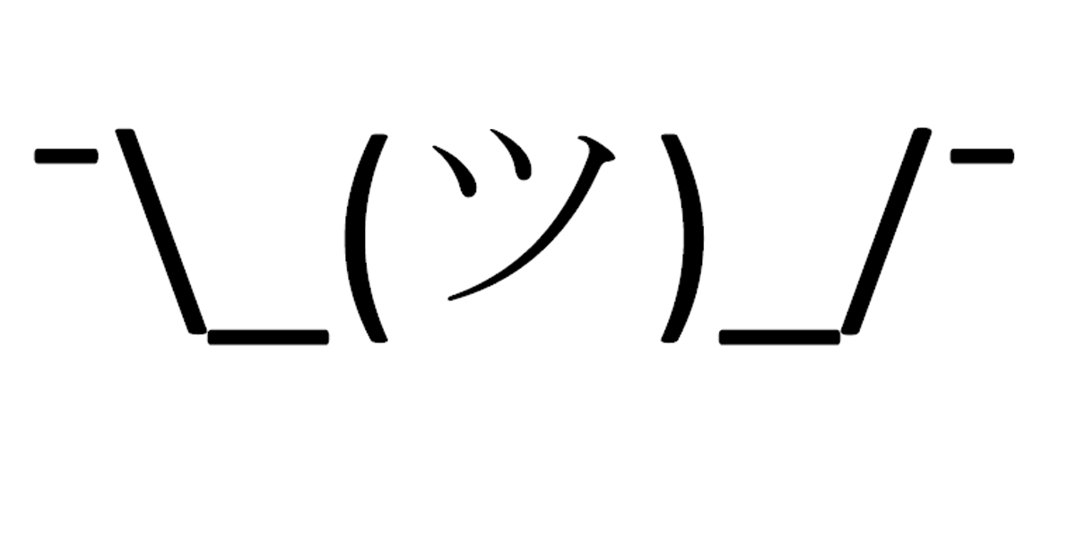
Failure Tolerance I: The Checkpointing / Restart Pause
A checkpoint is a persistent record of the state of the processor at a specific time
Saving and restarting from checkpoint take time, especially for large internal states
Even low latency processors have momentary pauses when restarting → consumers prepare!
Things can go really out-of-order!
Position in input stream
1
0
1
1
0
1
1
0
0
0
1
0
1
1
0
1
Checkpoint may contain position, internal state, status of output
Latency inconsistent!
Time
Output
Output stream
Notes:
Restarts mean pause + catchup -> need to tolerate by receiver!

Slide 15
Set of Defaults Ready for Rare Restart Pauses
“Here are some default options: …”
Restart Pause
Store
Notes:
Can be tolerated by for example by default / heuristic response

Slide 16
Failure Tolerance II: At-Least-Once Processing = Avoiding Data Loss
If failure occurs between checkpoints but output is continuous, rewind to last checkpoint → output duplication!
Options: batch outputs → increased latency / checkpoint after each output → decreased throughput
Take back past outputs (manipulate output position) to ignore redundant outputs, see idempotency
Position in input stream
1
0
1
1
0
1
1
0
0
0
1
0
1
1
0
1
Checkpoint may contain position in input, internal state, status of output
Idempotency or you can only have one
Output between checkpoints
Latency
Throughput
Failure
Notes:
Failure in a batch means replay of outputs -> more-than-once

Slide 17
Exactly-Once Processing
Checkpoint after each output → decreased throughput
Have to acknowledge each record individually at every step in the pipeline → increased latency
Position in input stream
1
0
1
1
0
1
1
0
0
0
1
0
1
1
0
1
Checkpoint may contain position in input, internal state, status of output
ack
Output between checkpoints
Latency
Throughput
Notes:
Checkpoint on each output is expensive

Slide 18
Exactly-Once Processing vs Idempotency
Exactly-Once: transactional aggregates, e.g. bank transfer → current balance
At-Least-Once with Idempotency: upsert transaction-with-ID, compute balance as derived quantity
Precomputed view or
consumer / DB compute aggregate for requested key
Position in input stream
1
0
1
1
0
1
1
0
0
0
1
0
1
1
0
1
1
0
1
1
0
1
1
0
0
0
1
0
1
1
0
1
ack
ID
Redis
RocksDB
DynamoDB etc
Output between checkpoints
Idempotent upsert
ID
Latency
Memory Usage
Throughput
Latency
Throughput
Memory Usage
Notes:
Idempotent processing permits multiple outputs that are upserted into aggregate state

Slide 19
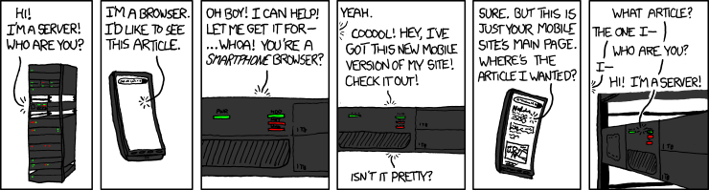
A Frustrating Customer Experience
Are customers interested in your product but can’t find it?
Loss of sales, customer relationships, and reputation
https://xkcd.com/869/
Notes:
Making content hard to find for customers costs money

Slide 20



Fast-changing Interest in Various Products – Alert of Sudden Changes Example: Product Featured in Mass Media → real-time alerting
“Here is the product most of you are interested in right now”
Notes:
Companies that respond to fast-changing interest quickly have a competitive advantage

Slide 21
Windowing Latency – Aggregate Output After Window Closes
Event time
Time
Latency
Memory Usage
Throughput
Sliding windows
!
Output “green for window 1”
Notes:
Windowing aggregates cause explicit wait time for output

Slide 22

Low Latency Windowing – Continuous Output of Partial Results After Each Record tiny.cc/ahnung-deck
Event time
Time
Latency
Memory Usage
Throughput
?
?
?
?
?
?
?
?
?
?
?
Upsert into
scalable external state as example
?
?
?
?
?
?
?
?
?
?
?
?
?
?
?
?
?
?
?
?
?
?
Extrapolate predictions from partial output
Notes:
Instead, output regular updates during window time to permit predictions and early alerts

Slide 23
Pauses and Latency, Data Design Decisions
Even when designed for low latency, resilient distributed streaming applications in general experience short restart pauses and catchup bursts when automatically recovering from intermittent failure
Data consumers need to plan with fallback heuristics in place to bridge these pauses
Streaming applications can be carefully designed to fulfill business needs for latency vs throughput vs cost vs output as stream or queriable state (depending on data consumers):
Internal vs external state for aggregations
Data locality options as optimization
Windowing: latency vs intermediate result extrapolation
Time
Output
Notes:
Conclusions slide

Slide 24
Streaming App Design Cheat Sheet
External State,
Local Data
Internal State
External State
Exactly Once
Idem potent
Window
Latency
Partial
Output
Stateless
Latency
Memory Usage
Latency
Memory Usage
Throughput
Latency
Memory Usage
Latency
Memory Usage
Throughput
Throughput
Throughput
Latency
Memory Usage
Latency
Throughput
Latency
Memory Usage
Throughput
Latency
Memory Usage
Throughput
Throughput

Slide 25

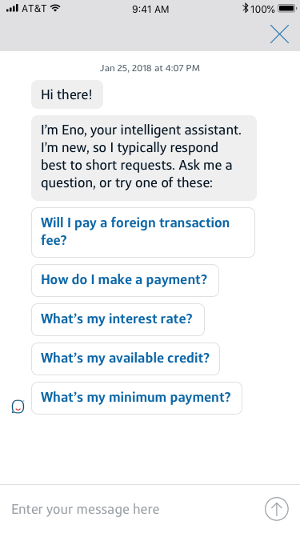
Capital One’s Chatbot Eno predicts customer needs: Eno's Quick Reply Model
Customers will receive a personalized, intuitive experience with tappable question options
Customer needs handled more quickly and in context
Result of a collaboration across multiple teams
Notes:
One of many applications of the infrastructure we have built at Capital One -> more in active development!

Slide 26
We’re Hiring!
andreas.markmann@capitalone.com
linkedin.com/in/andreasmarkmann
stop by our office hours 2:00 - 2:40pm room 302
or booth till 3pm watch www.capitalonecareers.com - search for ECI jobs

Slide 27
Appendix Simple Aggregate Estimator tiny.cc/ahnung-deck
Event time
Known message arrival latency distribution
Time
Red area under curve gives weight w,
Measured rate M, expected aggregate E
Scale up to total scaled aggregate S = M/w, Output weighted average result R:
R = w*S + (1 - w)*E
= M + (1-w)*E

