Slide 1

Building a knowledge graph platform from billions of unstructured online sources using AI

Slide 2


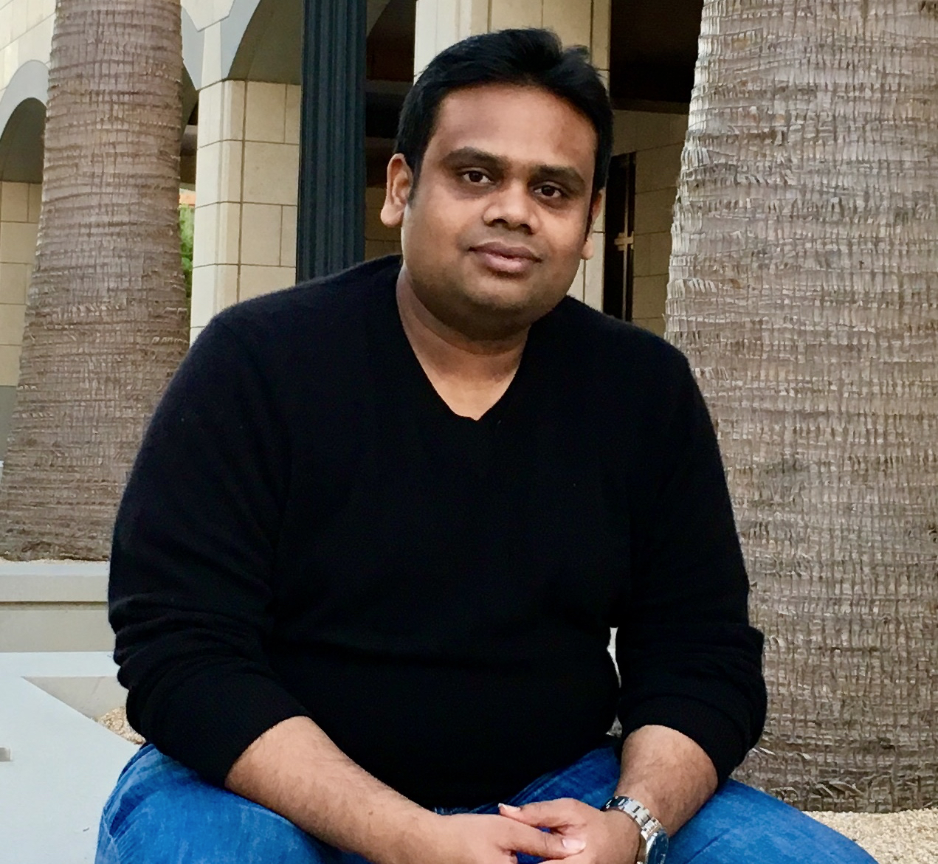




My Background
‹#›

Slide 3
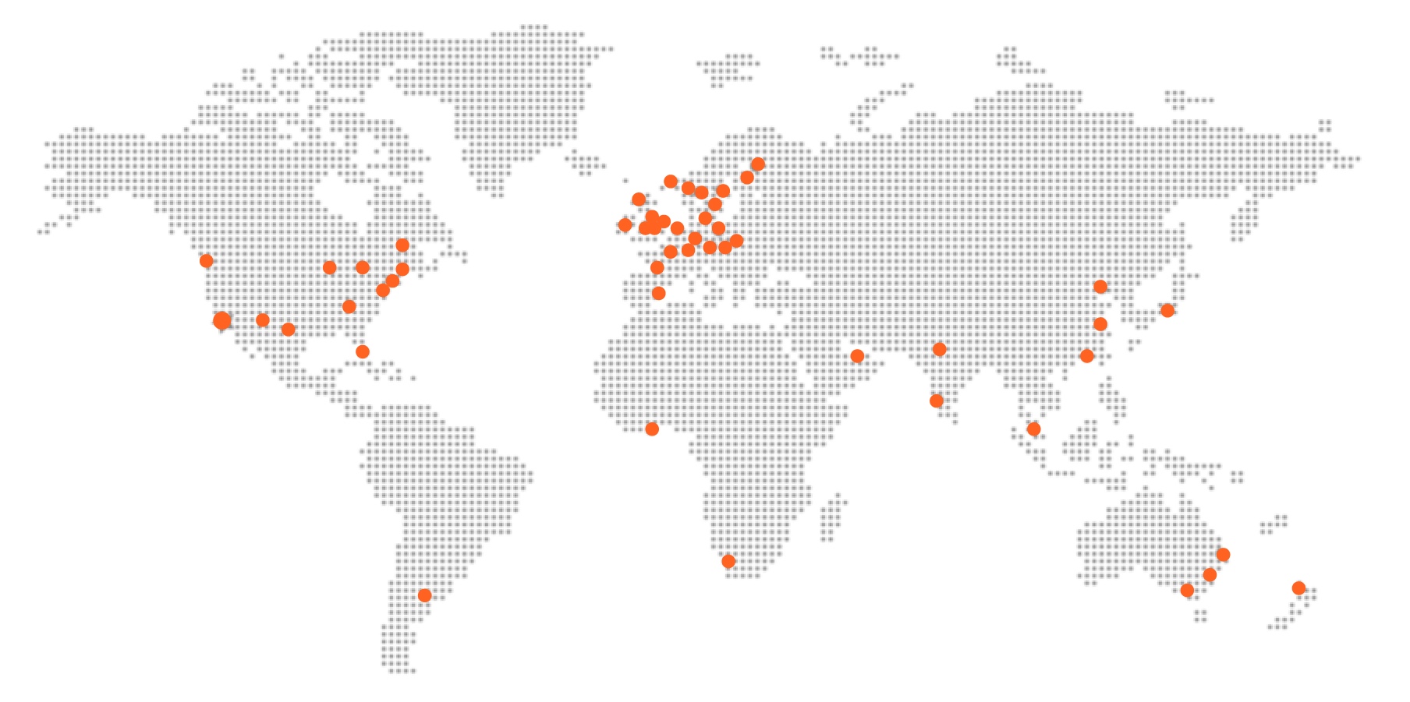






Meltwater: a truly global partner
HEADQUARTERS
in San Francisco
2000+ employees
worldwide
30,000+ Clients
Worldwide
60 + Offices across
6 continents
Bootstrapped
No venture funding
Leading AI Disrupter

Slide 4
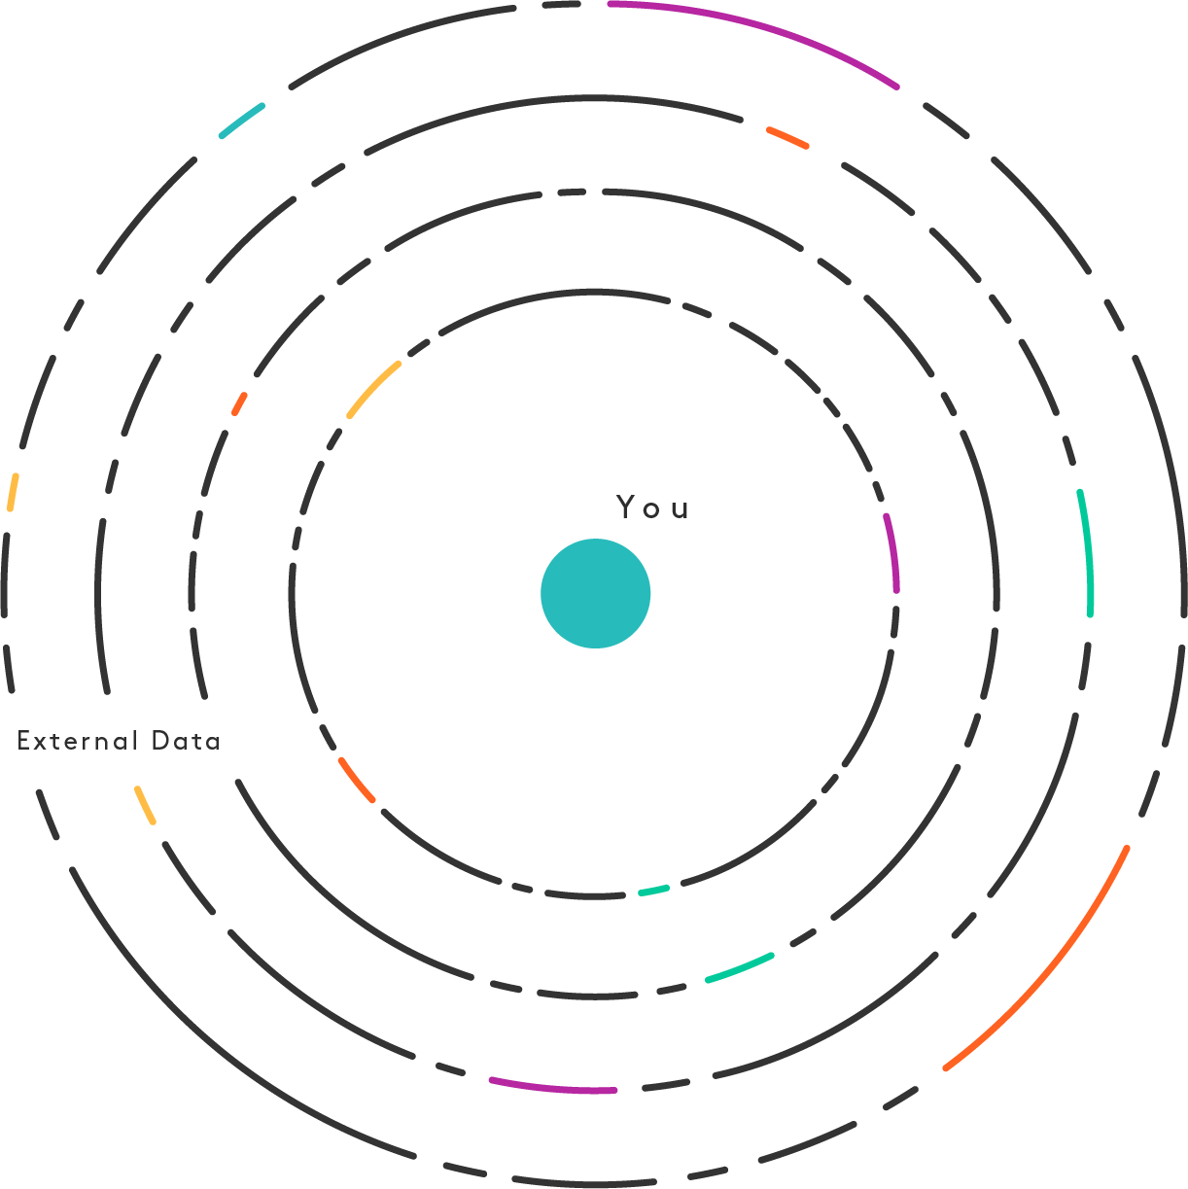
Our mission
For nearly 2 decades, Meltwater has developed technologies that enable better, more forward-looking decisions based on insights from external data.

Slide 5
Decision-making has not caught up with our new digital reality
Today, all of us leave behind a trail of online breadcrumbs, creating troves of external data.
Online news
Job postings
Product reviews
Share price
Real-estate rates
Interest rates
Financial filings
App downloads
Oil price
Social media
Press releases
Court documents
Patent filings
Trademarks
Unemployment
Web traffic
Online ad spend
Consumer confidence

Slide 6

Outside Insight is a new software category
Outside Insight leverages AI and ML technologies to derive insights from unstructured, external information, enabling more informed, forward-looking business decisions.

Slide 7
Impact: a new, predictive decision timeline
Predictive signals
Media Response
Monitor signals derived from external data
Monitor reaction to event across media, social and more
Predictive Analysis: Monitoring Signals
Event
Reactive Analysis: Industry Today, Monitoring News
2-3 mo. Before
0
1-5 Days
1-3 mo.
Real-time Events
Trending Report
Alerts on key events, influencer posts, campaigns and more, as they happen
Monthly/quarterly analysis
Notes:
Tie in this narrative to above -
OI is 2018, rest is up to now
Talk about competitive landscape. The reactive part is how the MI industry looks and operates today. We will identify which signals will have an impact on chosen company

Slide 8
Who is benefiting from Outside Insight?
WHO NEEDS OI?
Investors: surface relevant investment opportunities, monitor existing portfolio
PR& Marketing professionals: gain valuable customer insights, monitor your brand reach and perception, discover target accounts
Boards + Executives: benchmark against the competition, keep an eye on changes in the industry, identify business opportunities or threats in real time and offer unbiased, predictive insights to all stakeholders
Sales leaders: surface and monitor relevant target prospects
Product developers: discover market feedback in real time, gain competitive intelligence
Intelligence team: stay ahead of changes in the market, deliver data-driven recommendations

Slide 9










































30,000+ corporate clients

Slide 10
AI is necessary to make sense of external data
Challenges with external data | Technology needed
It’s unstructured | Data Mining
It’s mostly text | Natural language processing
It comes in many languages & shapes | Domain Adaptation
It can be deceitful | Factual knowledge extraction
It’s difficult to connect the dots | Machine Learning & Reasoning
It contains forward-looking indicators | Predictive algorithms
It’s very, very, big data | Cloud-based computing

Slide 11
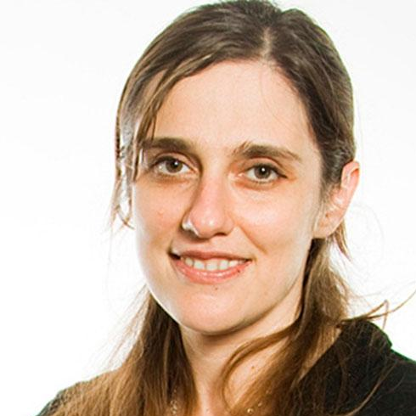
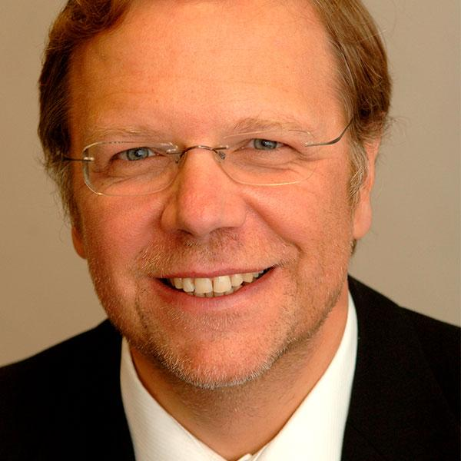


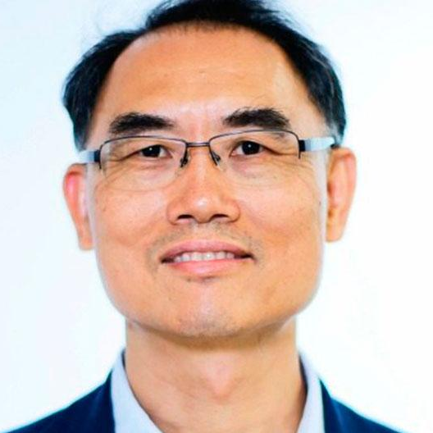
Meltwater’s Scientific Advisory Board
Leading global expertise in:
Web data extraction
Knowledge Graph
NLP & IE (Multi-Lingual)
Domain adaptation
Information network analytics
Regina Barzilay
MIT
Georg Gottlob
Oxford University
Jure Leskovec
Stanford University
Eric Nyberg
CMU
Qiang Yang
Hong Kong UST

Slide 12




Knowledge Graph platform that powers everything
Complete:
Data + AI Models + Data Science Tools + Analytics
Knowledge Graph
at the heart of Fairhair.ai
Insights
Services
Building blocks for
actionable insights
Outside
Data
Proven:
Powers Meltwater offering for +30,000 businesses
Enrichment
Services
Unlock meaning with
Machine Learning
World’s largest corpus
of outside data
Embedded:
API embeds insights into 3rd party & enterprise solutions
Notes:
Talk about Why we built FH.ai, focus on the value of the vast amount of data and the enrichments we offer. Talk about how firms can use our enrichments plus their data science or we can build the models for them.
Its a proven platform that powers our 30k customers

Slide 13
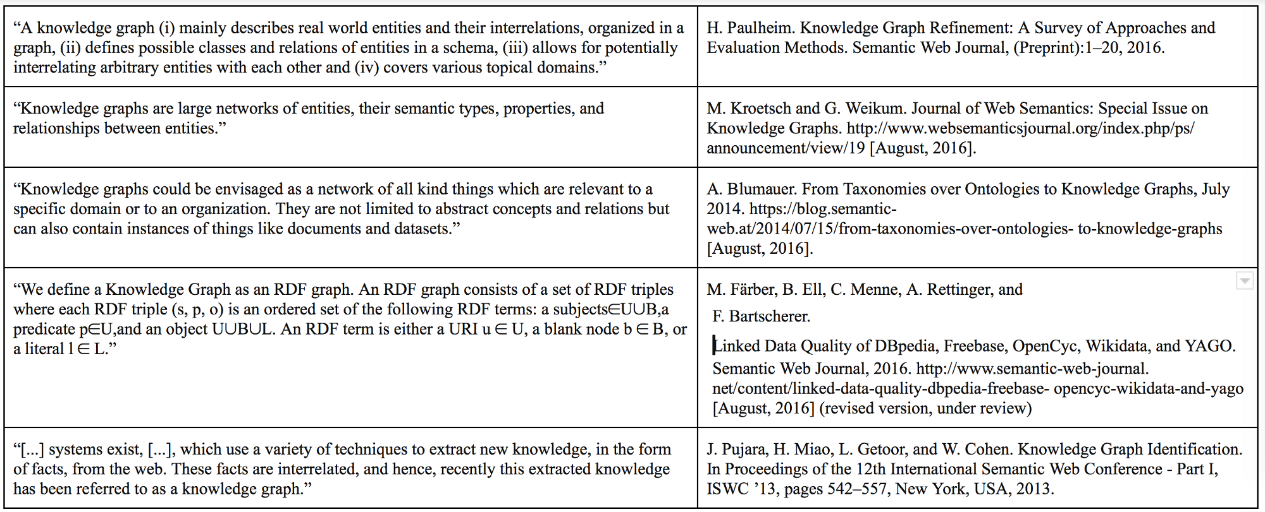
Knowledge Graph – What is a knowledge graph?

Slide 14
Knowledge Graph backed Platform
Index all the Outside data around entities
Company
Website
Editorial
Social &
Marketing Data
Job Posts
Public Filings
customers
trends
financials
Extract attributes, relationships, events, trends, predictions over time
offices
launches
reviews
sentiment
roles
patents
execs
competitors
engagement
outlook
Tools & Services for discover, connect, understand & deliver
products
influencers
ad-spend
regions
risks
Notes:
Aditya

Slide 15
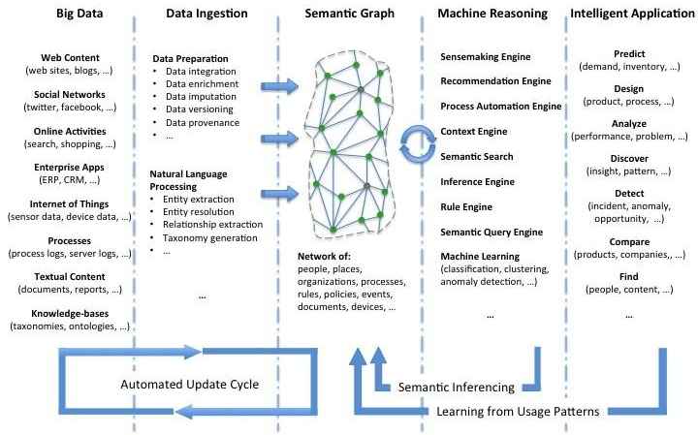
Importance of organizing as a Knowledge Graph
Fairhair.ai
Whole AI lifecycle
Centered on KG
Company focus
Notes:
Aditya

Slide 16
Knowledge Graph – The Heart of Meltwater’s World
PageRank (Graph Walkers)
Trained models
10M
outside sources
Graph embedding
Graph
Aggregation
Graph
Convolution
Hybrid Inference
inferred facts
0.6B+/day
Knowledge Graph
AI crawlers
& fetchers
derived facts
customers
trends
financials
10B+/day
offices
launches
reviews
Graph
Chase
Rules
Graph database
NLP
(NER, NED, RE, EE)
sentiment
Ontology
roles
patents
execs
competitors
engagement
outlook
Graph Reasoner
products
influencers
regions
ad-spend
risks
Data Platform

Slide 17
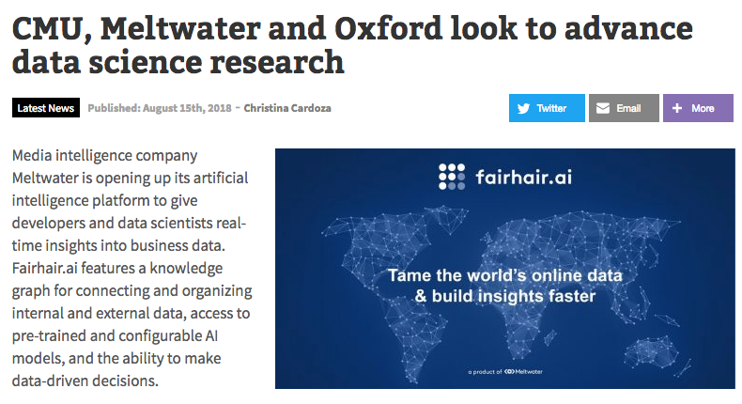






Academia collaborations
Top researchers and graduate students have worked with Fairhair.ai on projects including:
Crypto Challenge: Looking to beat our current crypto forecasting models using features derived from global data sources
Entity resolution: Identifying occurrences of same entity when integrating multiple sources
JSON crawling: Automatic translation from visual & HTML crawlers to JSON APIs (10x speed increase)
Graph rule mining: Mining rules for inferring new or erroneous data in KGs (~ 5% errors in DBPedia)
Fake news detection: UK-funded project that aims to discover fake news in our firehose
Question answering: EU-funded project for Q&A multilingual knowledge graphs
ACAI: A challenge layer to beat state-of-the-art natural language processing tasks

Slide 18


World’s Largest Corpus of Outside Data
1.3T Documents | Millions of Sources | 80+ Languages
100+ Real-time
Data Feeds
Web Data Extraction
Open Data Processing
Licensed and Compliant Data
Crawl from the Open Web
Bring your own Data
Unified Data Model and Processing Language to extract data from our partner network
AI powered web data extraction engine collects structured data from the open web.
Inject your own data (over 20 file formats) into fairhair.ai to map, enrich, and analyze.
Notes:
Aditya

Slide 19
Sources of Information
Text
(Information Extraction)
DOM
(Web Extraction)
WebTables
Annotations
(Site Microdata)

Slide 20
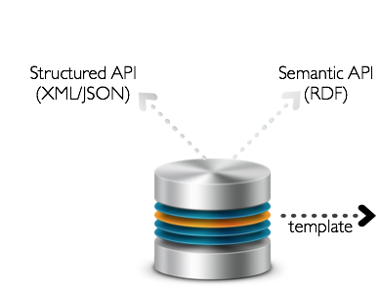

The academic web
Typical comments about web data extraction
Microdata and the semantic web have solved problems
All the data is in web tables
API’s provide all the structured data you need
Notes:
Mention about open knowledge

Slide 21
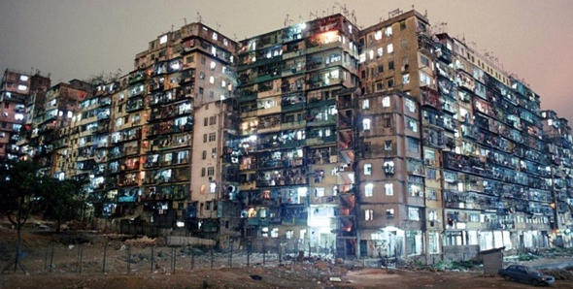
The real web
Web data extraction is not a solved problem
API’s are limited to large websites
Web tables and microdata are marginal
The real problem is not one-time extraction, but keeping the data up-to-date over time
Notes:
Open knowledge network

Slide 22
Traditional Scraping → AI Crawling
Traditional scraping requires a huge human effort:
Code wrappers for each source, e.g., in Scrapy or MW’s source configurations
Visually testing and support tool (ala Connotate, Mozenda, …)
Automatic scraping for small number of fixed data types (ala Diffbot), e.g., Microdata
Meltwater (old): ~50 “source engineers” maintaining manual wrappers
  sources failing at a rate of 100’s per week, 1-2h to fix each source effectively

Slide 23
Web-Scale Wrapper Induction
We need to scale to the web
  minimize supervision per source
But: we can afford prior knowledge
  about entities and attributes
  mostly in form of known shallow knowledge graph for domain knowledge
    expressed as Gazetteers or rules for local, textual information
    higher-level rules or classifiers for complex structures

Slide 24
Web-Scale Wrapper Induction
Problem: application of prior knowledge is costly & noisy
wrapper induction to generalise to other pages of site
“template” hypothesis
Solution: Generate “wrapper” program from examples
then apply to all pages of a site
when to apply which extractor
Full site extraction needs to also deal with
Interactivity such as pagination & form filling (deep web)
Detecting complex structures such as lists, tables, …

Slide 25
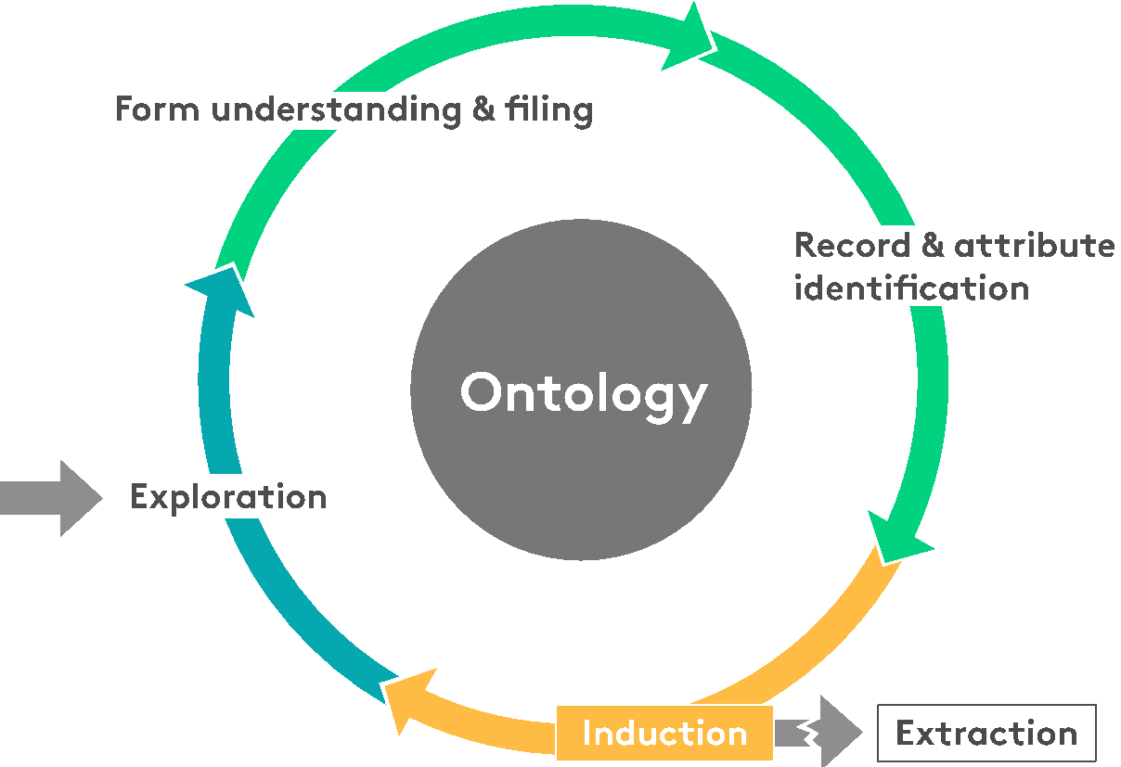
Fairhair.AI Crawlers
Exploration
Focused crawling
Stop conditions
Relational transducers
Template Discovery
Data areas detection
Record segmentation
Attribute alignment
Domain Modeling
DOM annotation (dictionaries, regexes)
Web phenomenology (forms, fields, labels, menus)
Conceptual models
Form Understanding
Labelling
Classification
Filling
Framework for rule-based feature engineering supporting quick turn around for domain-specific rich features on top of a library of 2.5k pre-built features representing structure, visual rendering, and textual content of a webpage, as well as the link structure and interaction patterns of the entire site.
Notes:
(1) Hybrid AI engine that combines strong symbolic reasoning with trained classifiers.
(2) Framework for rule-based feature engineering supporting quick turn around for domain-specific rich features on top of a library of 2.5k prebuilt features representing structure, visual rendering, and textual content of a webpage, as well as the link structure and interaction patterns of the entire site.
(3) AI driven self-adaptive exploration component that uses guarded FSM’s for a representation of the exploration space that is orders of magnitude more compact than traditional FSMs.
The famous LNER/SNER, where we infer the type and possibly the specific ID of an entity not just from the textual context, but also from attached labels in form of form labels, CSS attributes, ID attributes, table headers

Slide 26
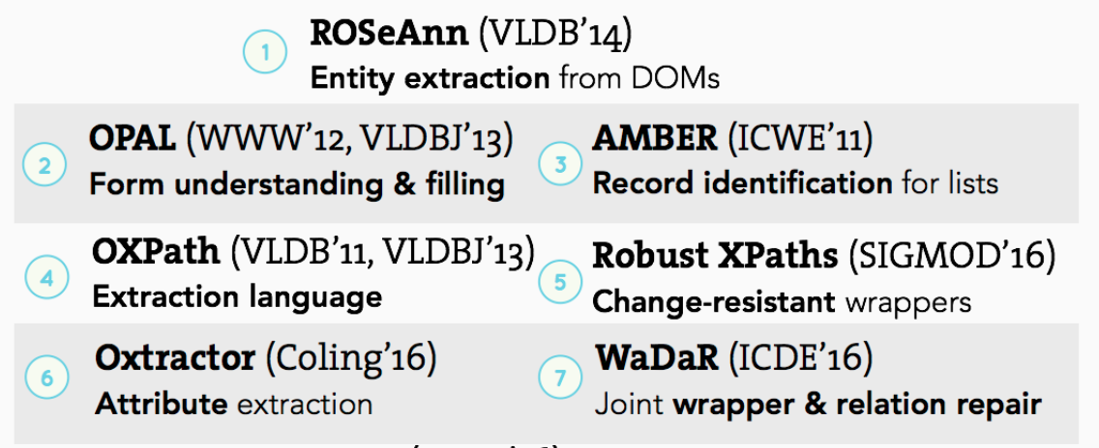
After series of strong publications

Slide 27
Effects of AI Crawling
80-90% lower
human effort
3-10x more
attributes
10-100x
more sources
without loss in quality compared with state-of-the-art
and domains than existing automated solutions and affordable supervised one
e.g., 300k+ news sources, 1M+ of company websites, Job postings, Press releases

Slide 28
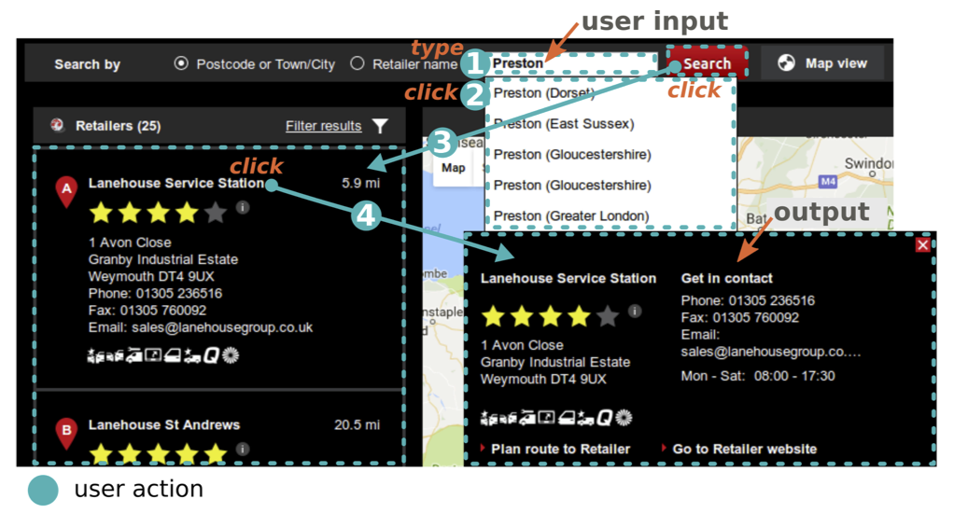
New frontier: Browserless Extraction
From visual or DOM wrappers to HTTP API wrappers

Slide 29
Browserless Extraction: JsonCrawl
Currently about 100’s sources use manually created
  JsonCrawl configurations in Meltwater
  Faster (5-10x) than even non-visual, DOM only wrappers
  More robust to changes (especially in China)
But: hard and time consuming to create initially
Automatic translation from automatically created source configs
  Possible in over 75% of the cases we have seen
  Manual escalation for the others

Slide 30

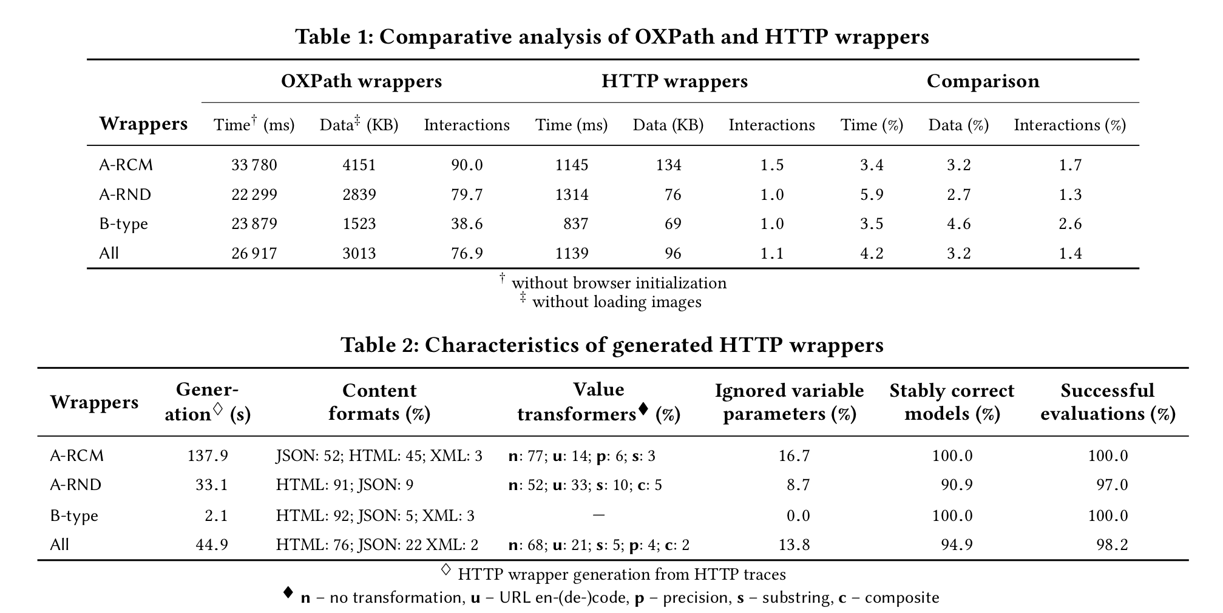
WWW’18: Browserless Extraction
Results

Slide 31
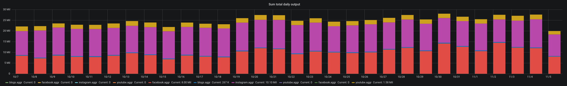




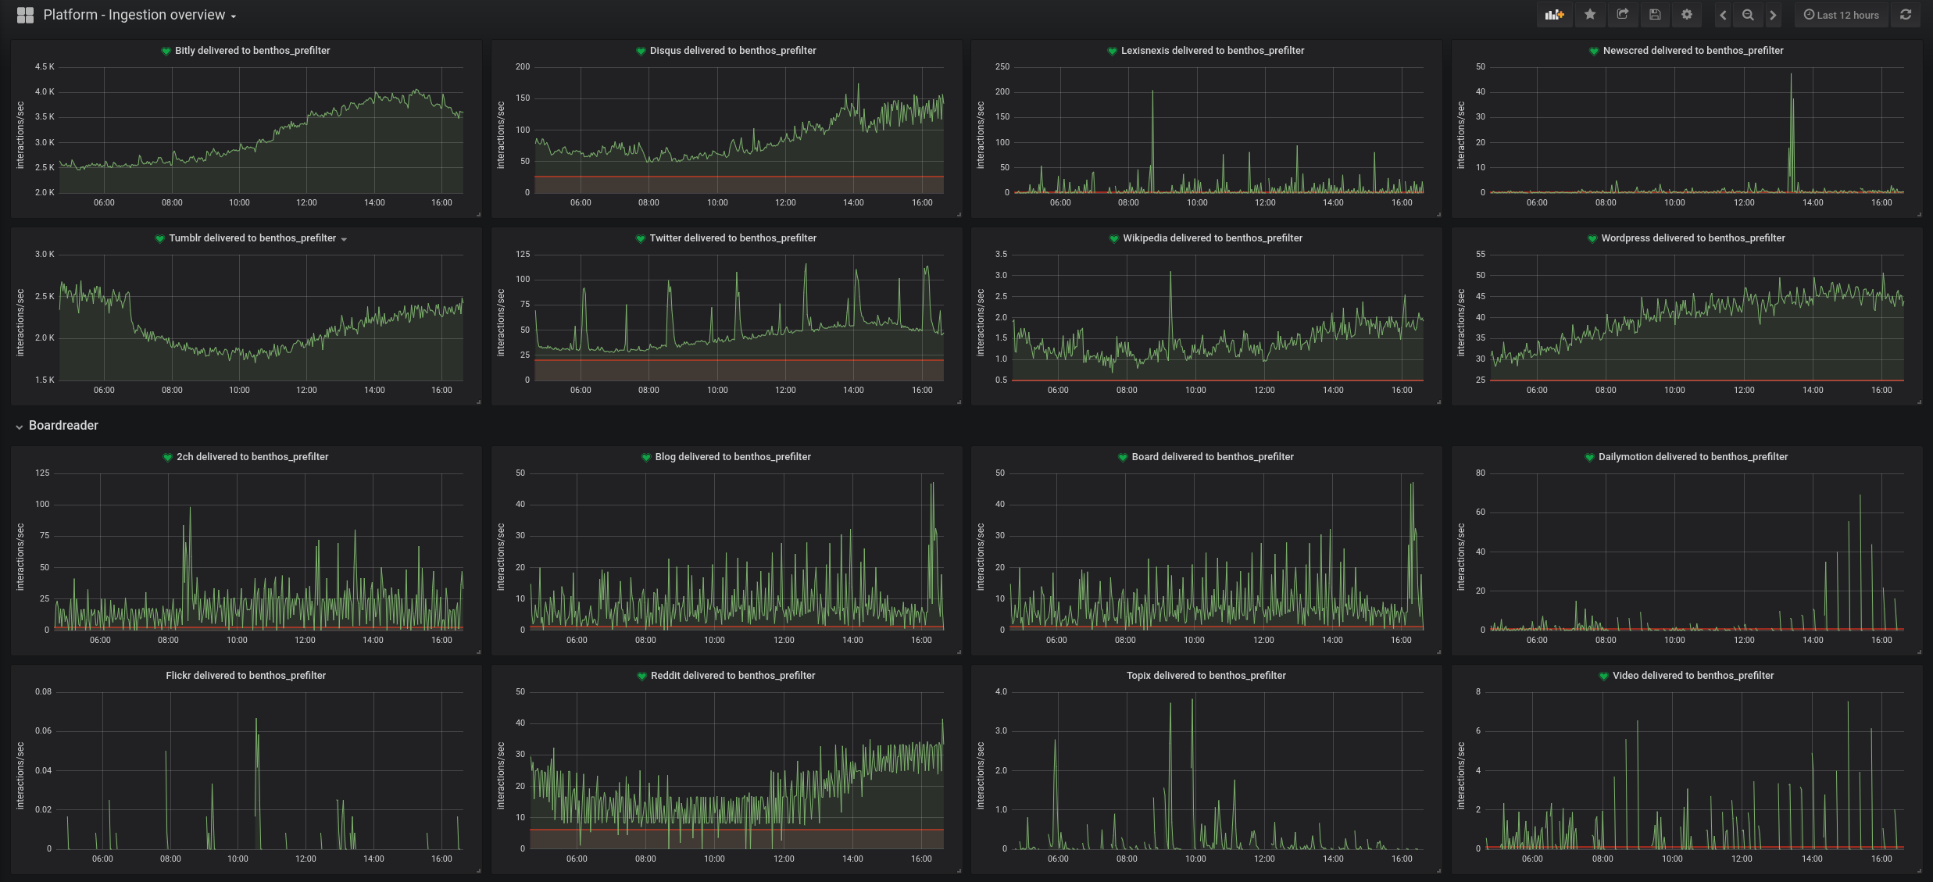
















Lots of Firehoses & API Fetching

Slide 32

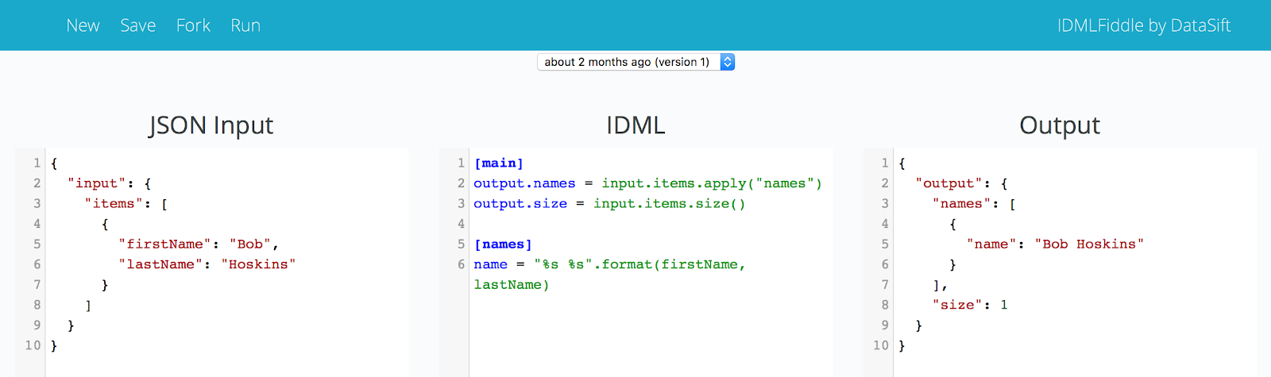
Ingestion Tooling
Configuration-based data mapping language to convert JSON documents between two schemas. http://idml.io/
Accessible - Designed for Analysts, Product Managers, Tech Writers, Support, Sales Engineers and Software Engineers alike
Concise - Free yourself from error-prone boilerplate code like null pointer checks and parse exception handlers
Extensible - Out of the box it has support for things like regular expressions, email and geolocation but it’s easy to add new modules
High-performance - Built for firehoses
Java-based - Integrates with the emerging big data stack, including Hadoop MapReduce and Kafka

Slide 33

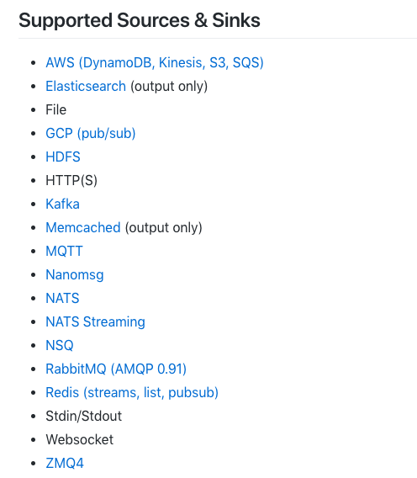
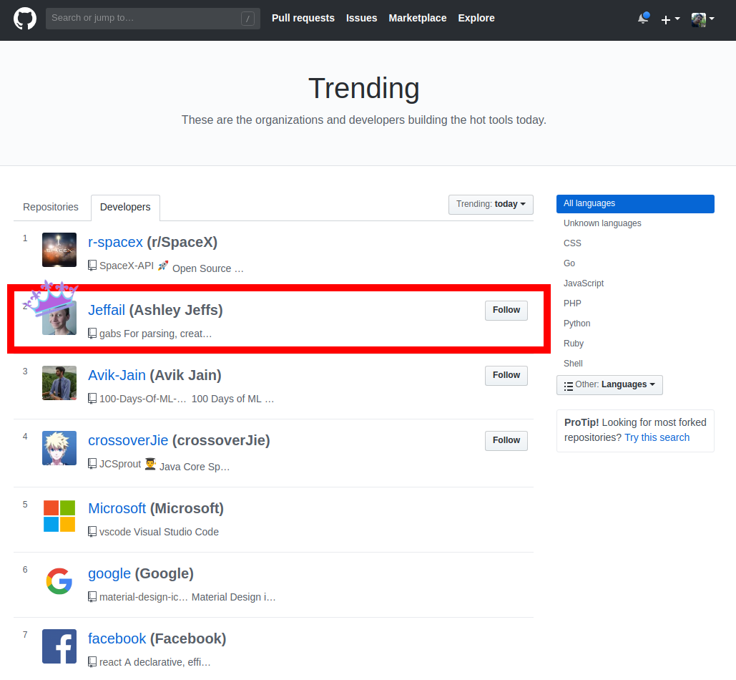
Benthos
Main use: To bridge various components of the Platform, to ingest firehoses, to produce and consume from the DataBus, …
Performance:
Latency avg as low as 200μs (with 99th within 1ms), throughput as high as ~100k docs/s per server

Slide 34
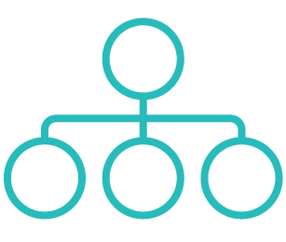

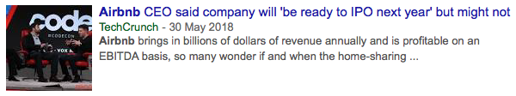



Proprietary enrichment services which derive meaning, add context
Context-Driven NLP applies multiple models, built for different content
Categorization
Entity extraction & linking
Evergrowing taxonomies for several industries
Companies
People
Products
Places
Links
Events
Sentiment
Headline
Title
OpenGraph
What is this content ‘about’
eg. Market Expansion
Article Level
Sentence Level
Entity level

Slide 35
Natural Language Processing in Fairhair.ai
 | Lang Detection | Text Similarity | Text Classification | POS | Noun Chunking | Dep. Parsing | NER | NED | Key phrases / Themes | Concept Extraction | Sentiment Analysis | Relation Extraction | Summarization
fairhair.ai | ● | ● | ● | ● | ● | ● | ● | ● | ● | ● | ● | ● | ○
IBM Watson | ● | ○ | ● | ○ | ○ | ○ | ● | ● | ● | ● | ● | ○ | ●
MS Cognitive Services | ● | ○ | ○ | ○ | ○ | ● | ● | ● | ● | ● | ● | ○ | ○
Google NLP | ● | ○ | ● | ● | ○ | ● | ● | ● | ○ | ○ | ● | ● | ○
Amazon Comprehend | ● | ○ | ○ | ○ | ○ | ○ | ● | ○ | ● | ● | ● | ○ | ○
Intellexer | ● | ● | ● | ● | ○ | ● | ● | ○ | ○ | ● | ● | ○ | ○
Text Razor | ● | ○ | ● | ○ | ○ | ● | ● | ● | ● | ● | ○ | ● | ○
Aylien | ● | ○ | ● | ○ | ○ | ○ | ● | ○ | ○ | ● | ● | ○ | ●
Lexalytics | ● | ○ | ● | ○ | ○ | ○ | ● | ○ | ● | ● | ● | ○ | ●
Indico | ● | ○ | ● | ○ | ○ | ○ | ● | ○ | ○ | ● | ● | ○ | ●
Heaven | ● | ○ | ● | ○ | ○ | ○ | ● | ○ | ○ | ● | ● | ○ | ○
Meaning Cloud | ● | ○ | ● | ○ | ○ | ● | ● | ● | ○ | ● | ● | ○ | ○
Repustate | ● | ○ | ● | ● | ● | ○ | ● | ○ | ● | ● | ● | ○ | ○
22 languages & 3 media types (editorial, social, reviews)
Domain specific models
Cost control
Customization for data type
Introspection of models
No provider is complete
Volumes (excerpt)
~11k/s tweets
~120/s editorial
280/s WP comments
55/s Intense Debate
350/s Disquis, Sina, Instagram, Boardreader ....

Slide 36
Populate KG with entities & relations from text
Identify and disambiguate mentions of entities of interest in a document and its relations.
Tokenizer
+
Splitter
+
PoS
Tesla has announced the full acquisition of SolarCity which closed on Monday morning .
NNP
VBZ
VBN
DT
JJ
NN
IN
NNP
WDT
VBD
IN
NNP
NN
NER
Tesla has announced the full acquisition of SolarCity which closed on Monday morning .
ORG
ORG
DATETIME
NED
Tesla has announced the full acquisition of SolarCity which closed on Monday morning .
Tesla Science Center at Wardenclyffe
Tesla (Czechoslovak company)
Tesla, Inc.
SolarCity Corporation
City Solar AG
Black Monday
Monday
RE
Tesla has announced the full acquisition of SolarCity which closed on Monday morning .

Slide 37
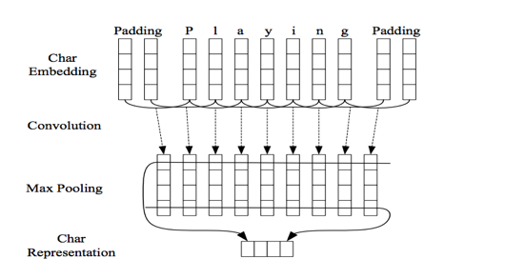
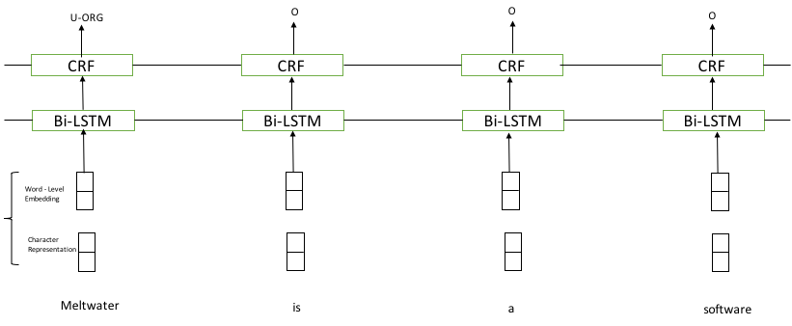
Named Entity Recognition
Overall Architecture
LSTM-CNN-CRF
Character-level embeddings
CRF | LSTM-CNN-CRF
Different embedding size --- token , character
Optimizers : Adam , RMSProp, SGD
Varying dropout rates
Changing number of hidden layers and units
Different regularization techniques
Averages pooling vs Max pooling for CNN
Varying filter and window length for CNN
 | F1 | Pr | Rec
PER | 0.91 | 0.92 | 0.90
ORG | 0.78 | 0.84 | 0.72
Total | 0.82 | 0.87 | 0.78
 | F1 | Pr | Rec
PER | 0.90 | 0.89 | 0.91
ORG | 0.78 | 0.85 | 0.73
Total | 0.83 | 0.86 | 0.79
Used in production
Notes:
We have both a classical CRF model for NER and a LSTM-CNN-CRF model using latest character-level embeddings
Currently both models perform close to each other and CRF model is significantly smaller and faster in inference
We don’t just chase the latest technologies but always verify that our solutions are at least as good or better than state-of-the-art

Slide 38



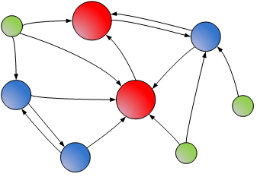


Named Entity Disambiguation
Plain text
NER Annotated spans
Tesla has announced the full acquisition of SolarCity which closed on Monday morning.
entity(0,5,ORG,”Tesla”)
entity(44,53,ORG,”SolarCity”)
entity(70,84,DATETIME,”Monday Morning”)
Tesla
SolarCity
Monday Morning
DBPedia’s AGDISTIS NED
LGPL v3
PageRank - Scoring algorithm
Indexed triple store
SolarCity
Corporation
Disambiguated entities
Tesla
|-> http://.../mw/Tesla_Inc
SolarCity
|-> http://.../dbp/SolarCity
Tesla
Inc.
‹#›
Notes:
We moved away from HITS to PageRank largely as it is easy to precompute
Removing information from the index that is not directly connected to the graph and precomputing pagerank on the entity graph reduced the size of the index from 13Gb to 3Gb -> faster lookups, reduced coldstart from ~15secs to ~3secs

Slide 39
Problems and solutions
Problem: AGDISTIS only receives named entities, thus it’s disambiguation context is limited
Solution: Complement the NER with a domain-specific (non named) entity recognizer and verbs.
We have a first version available for the business domain
Bootstrapped from large corpus of docs and a termbank generation algorithm
Tim Cook is the CEO of Apple. I know Bayer is a pharmaceutical company.
PER
BUSINESS
TERM
ORG
ORG
INDUSTRY
BUSINESS
TERM
Problem: AGDISTIS is language agnostic but the index is not. We were initially limited to English
Solution: Replicate the same process on other languages by mapping the index fields
Not all languages have comprehensive DBPedia fields
The English part (most richest) of the index probably has to be always present

Slide 40
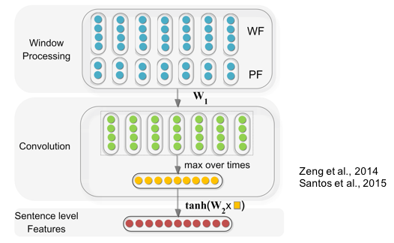
Relation Extraction
Predict the class of a (semantic) relation between pairs of entities in text
[Google] is taking on [Amazon] with its [Google Home] devices
Relation | Pr | Rec | F1 | Sup
Company-Competition(e1,e2) | 0.86 | 0.87 | 0.86 | 255
Company-StakeHolder(e1,e2) | 0.75 | 0.67 | 0.7 | 305
Company-Customer(e1,e2) | 0.62 | 0.83 | 0.71 | 158
Company-Customer(e2,e1) | 0.65 | 0.79 | 0.71 | 119
Company-StakeHolder(e2,e1) | 0.8 | 0.74 | 0.76 | 153
Company-Acquisition(e1,e2) | 0.68 | 0.81 | 0.74 | 113
Other-Relation | 0.85 | 0.82 | 0.83 | 283
Total | 0.77 | 0.76 | 0.76 | 886
competition(Google, Amazon)
CNNs
Word embeddings (WF): Distributed representations of words that map each word in the text to low dimensional vector (word2vec).
Position embeddings (PF): Relative distances of each word to the entities. (Random init)
1. Relation Classification via Convolutional Deep Neural Network, Zeng et al., (2014), Proceedings of COLING
2. Classifying Relations by Ranking with Convolutional Neural Networks, Santos et al., (2015), Proceedings of the 53rd Annual Meeting of the Association for Computational Linguistics and the 7th International Joint Conference on Natural Language Processing
Notes:
How does this compare to state of the art?
F-Score is pretty good, some approaches have better precision at much lower recall and vice versa.
We have very little annotations also, so this likely could be further improved.

Slide 41
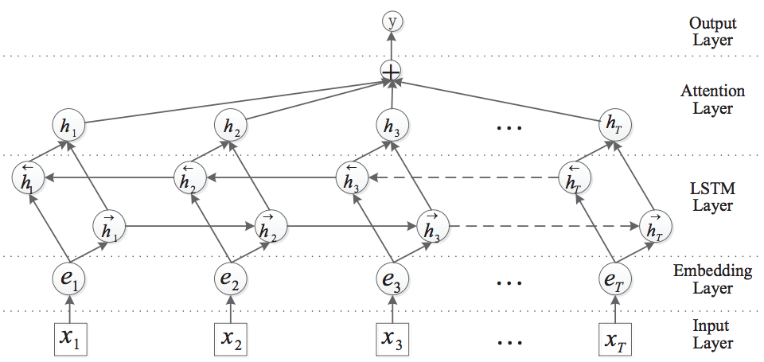
Relation Extraction
DL is expensive, high-locality of interesting extractions
Relation | F1 | Pr | Rec
Acquired | 0.9 | 0.87 | 0.93
Acquired_by | 0.76 | 0.69 | 0.85
Competitor_of | 0.77 | 0.76 | 0.78
Customer_of | 0.4 | 0.34 | 0.5
Invested_in | 0.61 | 0.91 | 0.45
Merged_with | 0.63 | 0.48 | 0.92
other | 0.5 | 0.45 | 0.56
Owner_of | 0.75 | 0.68 | 0.83
Partner_of | 0.65 | 0.66 | 0.64
Subsidiary_of | 0.83 | 0.73 | 0.96
Vendor_of | 0.37 | 0.28 | 0.52
{
Attention-Based Bi-LSTM
1. Attention-Based Bidirectional Long Short-Term Memory Networks for Relation Classification. Zhou et. Al, ACL (2016)
Notes:
Similar here
Obviously some relations simply don’t have very tight patterns (vendor, customer, …)

Slide 42
Populate KG with events from Textual sources
Editorial Event Detection Service
Empty
Event List
FALSE
NLP basics, NLP NER
Accept document?
TRUE
Pre-processing
(title cleaning, doc head + SpaCy)
Detect events
Event List
Only ‘accepted’ docs should be processed. Service uses detector pipeline to test acceptance of documents.
Service calls pipeline to detect events in the document.
Detector Pipeline
Manages a set of detectors.
A document is accepted if at least one detector accepts the document.
Events are collated from all detectors.
Detector
Detector
Detector
Detector
Event Detection Library

Slide 43
Next Gen Sentiment
Sentiment analysis means attaching a polarity (positive, negative, neutral, mixed) and a score to a piece of text.
I really like the new iPhone X. Battery-life is so much better than the Samsung Galaxy 8.
Document level sentiment:
positive (prob 65.87%)
Sentence level sentiment:
I really like the new iPhone X → positive (71.80%)
It’s so much better than the Samsung 8. → positive (59.93%)
Entity level sentiment:
iPhone X → positive (95.32%)
Samsung Galaxy 8 → negative (87.32%)
Term (a.k.a. keyword, keyphrase) level sentiment:
battery-life → positive (89.50%)
Aspect level sentiment:
battery → positive
Notes: in aspect level sentiment, terms and entities are mapped to abstract categories, e.g., in “This restaurant is expensive” → the term expensive is mapped to the aspect price.
Notes:
we (FHAI) never received the product market fit analysis for custom enrichments.

Slide 44
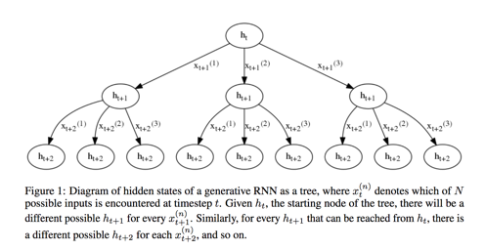
Our Sentiment Model
Network design
Single layer multiplicative LSTM with 4096 units
Mini-batches of 128 subsequences of length 256
4 Pascal Titan X gpus
Training took approximately one month
Trained on ~100M online reviews that are labelled
Multiplicative LSTM for sequence modelling. Krause et al., 2017
Learning to Generate Reviews and Discovering Sentiment. Radford et al., 2017

Slide 45
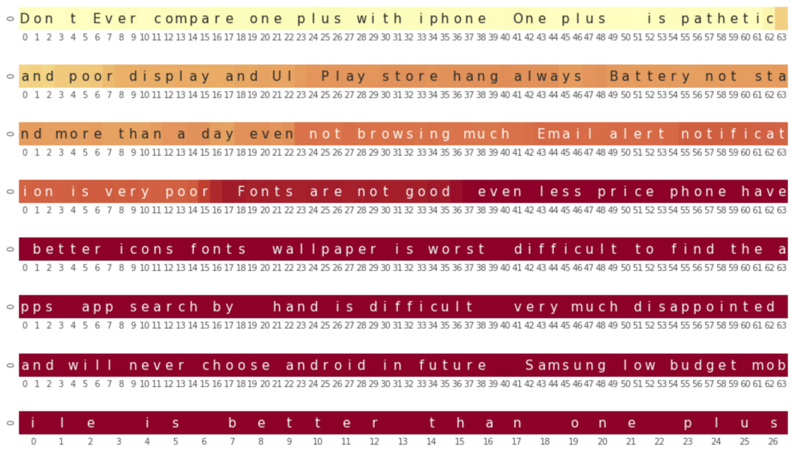
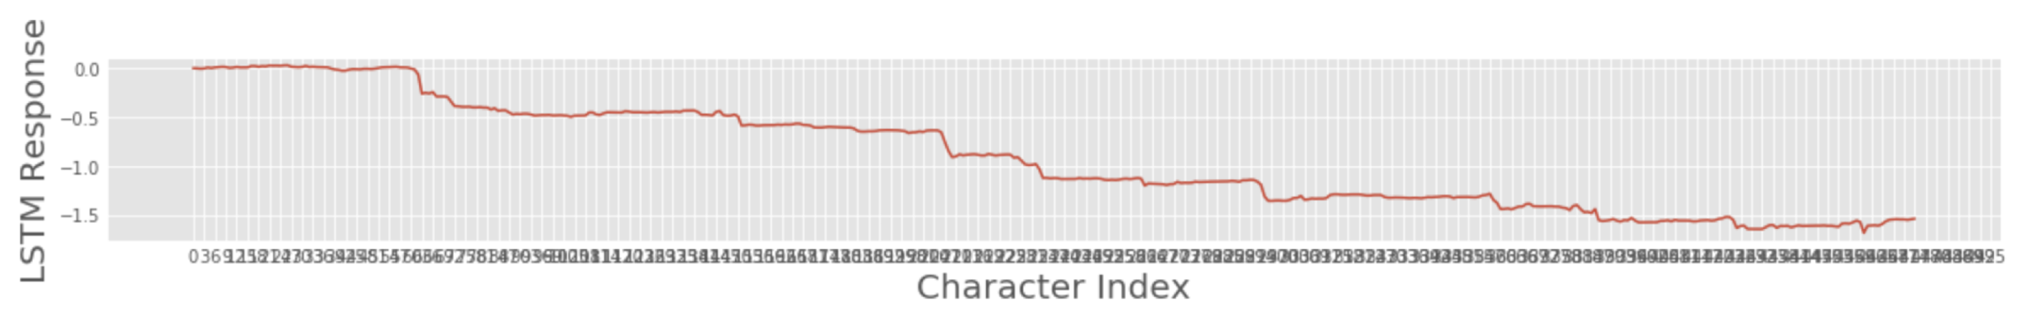
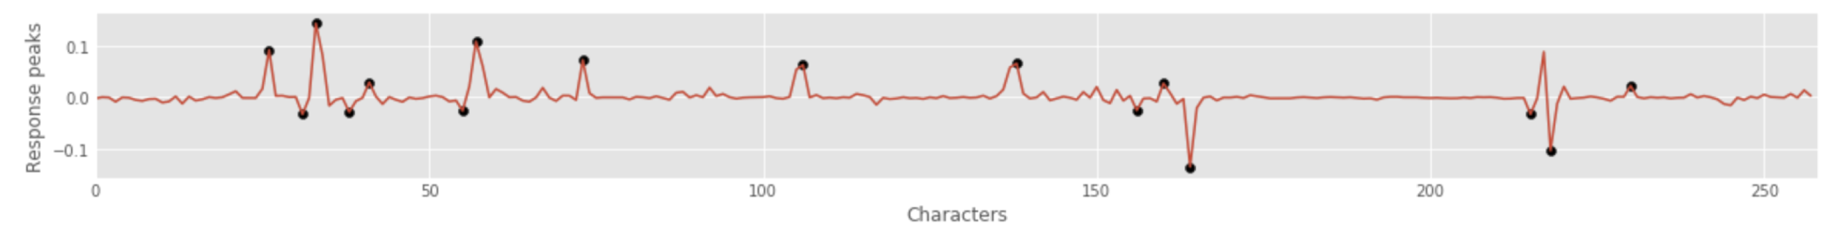
Lag Correction
The filled markers indicate shifts in the LSTM response that are used to extract keyphrases in the text and their corresponding sentiment value from LSTM response.
Aspect | Sentiment
Display | negative
Email alert notification | negative
Fonts | negative
wallpaper | negative
Multiplicative LSTM for sequence modelling. Krause et al., 2017
Learning to Generate Reviews and Discovering Sentiment. Radford et al., 2017

Slide 46
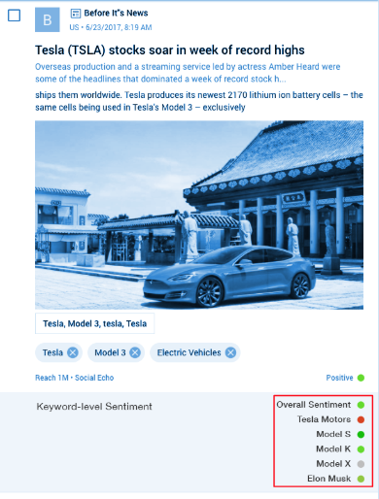
Next Generation Sentiment (Occurence level)
Input text
mLSTM encoder
Entity extractor
Keyword(s) target
Topic Extractor
encoder lag correction
Keyphrase extractor
Sentiment assignment
Sentiment assignment can be done on entities/Keyphrases/topics extracted or on run time targets
Will work on multiple data types

Slide 47
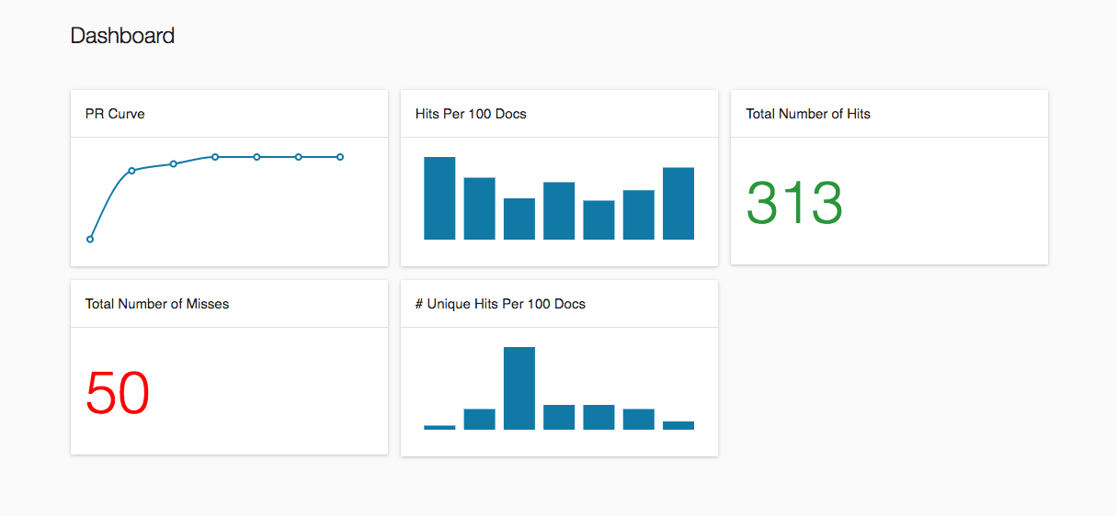
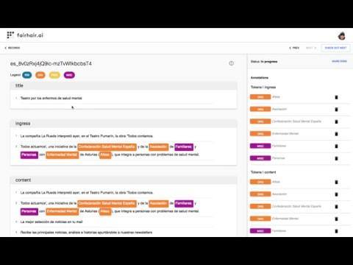


Training in Meltwater
Annotate Text, entities, classification and custom HTML
Task Assignment, Ranking, Inter Annotator agreement
Gold set creation for any structured data like NED, Knowledge Fusion
Custom Models

Slide 48

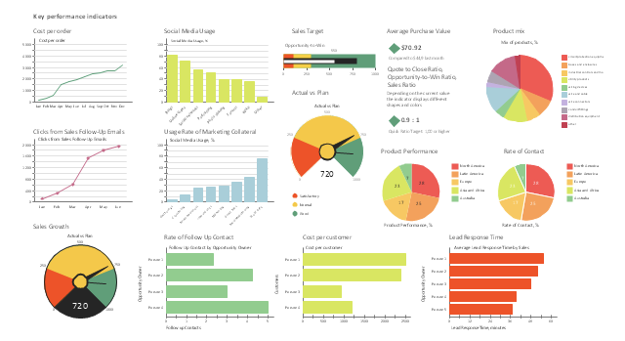
NLP/IE Pipelines
A workflow for analyzing datasets (Batch & Real Time)
NER₁
NED₁
RE₁
router
language
classifier
country
classifier
topic
classifier
DP
DL
NER₂
NED₂
RE₂
{
“topic”: “business”,
“language”: ”en”,
“country”: ”us”,
“section”: “body”
}
IR
The standard workflow fetching documents from the data lake
.
.
.
.
.
.
.
.
.
NER_{n}
NED_{n}
RE_{n}
NED index repo
Supports multiway data flows, e.g., for ensembles of NERs
CLASSIFIER TOPICS
Arts & Entertainment
Business
Demographic Groups
Environment & Nature
Events
Government & Politics
Health
Lifestyle
Living Things
Media
Science
Social Affairs
Sports
Technology
LANGUAGE-COUNTRY
en-us
en-uk
sv-se
fr-fr
fr-ca
...
model repo
nlp-data repo
DOCUMENT SECTIONS
title
ingress
highlights
body
captions
quotations
GS
repo
GS
scoring
versioned
SW
Every time a new component sw-version is registered a scoring task against the GS is triggered
registry
Studio
Notes:
This has to be done in 3 seconds.

Slide 49

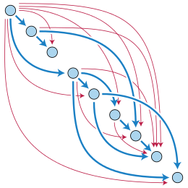
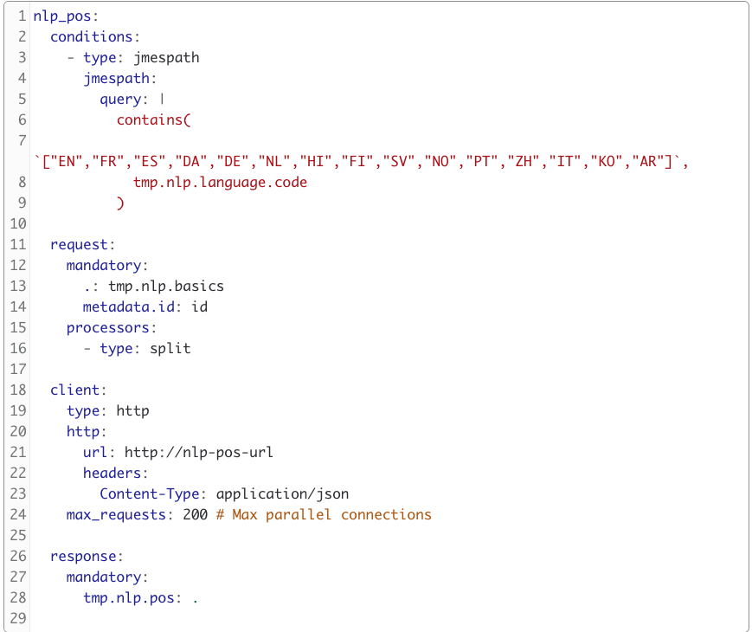








Swagfiend (Hosted Pipelines)
Workflow manager for most enrichment pipelines, handling dynamic, conditional workflows, automatic dependency graph, parallel service calls
On-demand,
Multi-tenant.
Static and dynamic configuration
I/O connectors for various protocols (see Benthos)
Automatic dependency resolution (DAG)
Data sources
Multiple input sources
Parallel workflows
Docs to be enriched
Enriched documents
Multiple, conditional output channels
100’s of pipelines in production
Enrichment services

Slide 50
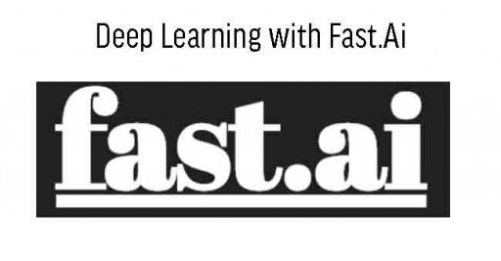



New Frontier in NLP
ELMo
ULMFiT
OpenAI transformer
BERT
Word2vec
Glove
Shallow Pretraining
Deep Pretraining
Notes:
Capture more than simple morphological differences, semantic and syntactical meaning of words - capture compositionality, polysemy, anaphora, long-term dependencies, agreement and negation
Two main paradigm used for training:
1. use the pre-trained language model as a fixed feature extractor and incorporate its representation as features into a randomly initialized model as used in ELMo
2. Task specific fine-tuning of the entire language model as done by ULMFiT.

Slide 51


Several sources for knowledge
Link all data we deal with to our underlying rich knowledge graph to enable reasoning of Insights
Improve our knowledge graph with extracted facts by continuously analyzing all outside data!
Social Media
Company Website
External KB’s
Information extraction
Web data extraction
WebTables
Site Microdata
Online News
SEC Filings
Knowledge Graph
Entities:
Relations:
Events:
Press Releases
Competitors
Suppliers
Customer
Partnership
Subsidiary
Investor
Executive
Acquisitions
Product launches
Key hiring and firing
Expanding operations
Bankruptcy
Restructuring
Cost cutting e.t.c
Company Database
Companies
Brands
Products
Coins
Key people
Influencers
Influencer
Job Postings
Patents

Slide 52
Record Linking
Challenge: link objects from multiple sources that refer to the same real world entities
Intel Capital
www.intelcapital.com
Intel
www.intel.com
CBS Television Distribution
www.cbstvd.com
Intel Corporation
Industry: semiconductor
CBS Corporation
HQ: New York, NY, USA
Intel Corp.
Stock: INTC
Combinent Biomedical Systems
Founded: 2000
CBS
www.cbs.com
“Same As”
Related (eg. subsidiary)

Slide 53
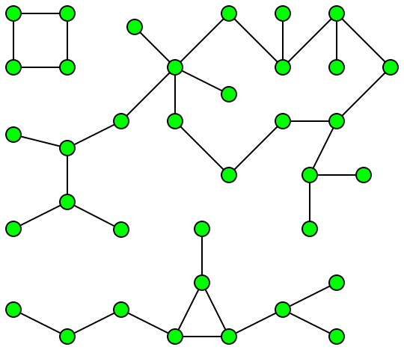
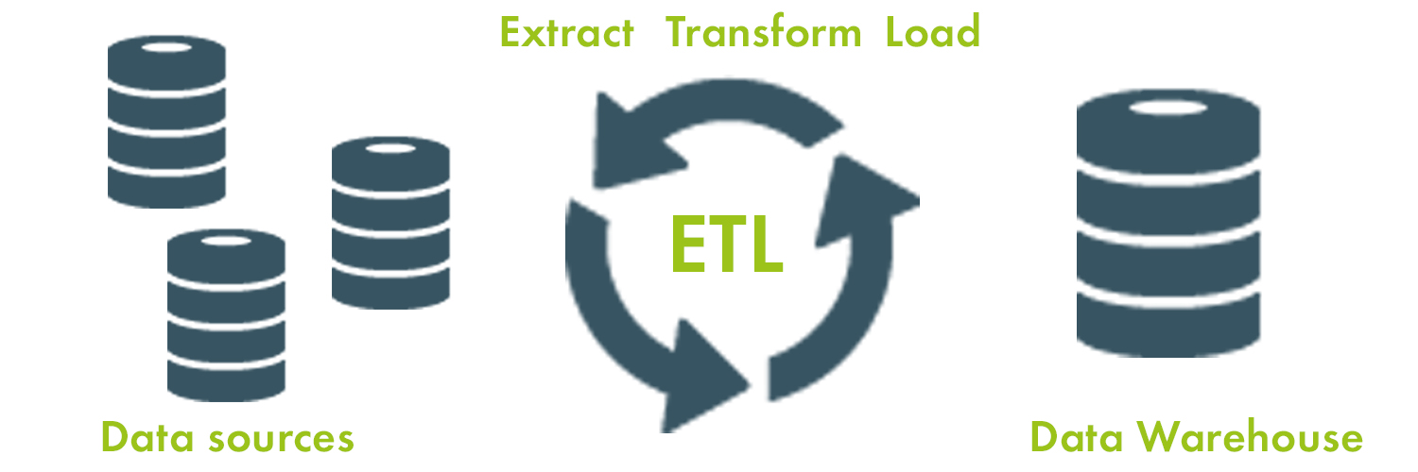
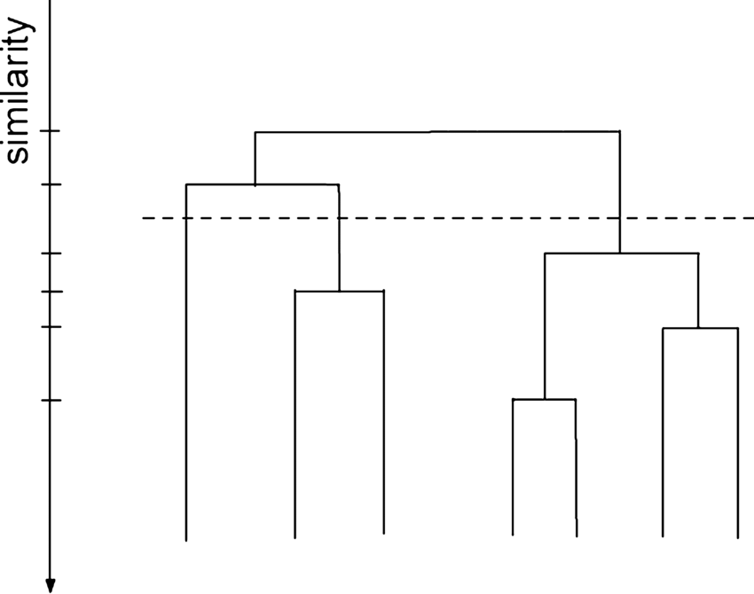

Record Linking Workflow
Schema mapping, normalization
Blocking
Source records
Pairwise similarity classification (Logistic regression)
{name1, url1, …}
{name2, url2, …}
Agglomerative clustering
Cluster UUID assignment
Intel Corp. 1234-5678
INTSC 1234-5678
Intel Capital 9999-1234
.55
Notes:
Agglomerative clustering allows us to select a granularity of the clusters by setting the agglomeration/cut off point

Slide 54
Record Linking Details
Blocking
  Reduce number of comparisons << O(n²)
  Connected components analysis (Apache Spark GraphX)
Pairwise similarity classification
  Calculate similarity score ([0, 1]) for record pairs
  String distance & ML model (regularized logistic regression)
Hierarchical agglomerative clustering
  Clustering using pairwise similarity scores
  Using cut-off threshold
Gold Standard | Precision | Recall | F1-score
50 orgs from Fortune1k 50 orgs from Wikidata | 0.87 | 0.92 | 0.90
1000 orgs from Fortune1k 1700 orgs from Wikidata | 0.92 | 0.92 | 0.92
Notes:
The blocking + similarity scoring approach is pretty standard, has been used for years. Agglomerative clustering gives us a bit of an edge and is nicely flexible
The approach and results are clearly state of the art
F-score is actually about 2-5% above most results in Yago or other open-domain extraction approaches
However, we only have a fairly small gold standard, so not sure that’s statistically relevant
Collective ER is getting pretty close to 98%, but complicates the system and

Slide 55
Truth discovery - aggregating conflicting data sources
Challenge: which noisy attribute provided from different sources about an entity is the most probable one?
Entity (Org) | Attribute (Country) | Source
Microsoft | US | Nasdaq
Alphabet | US | Nasdaq
Spotify | SE | Nasdaq
Spotify | SE | DBPedia
Microsoft | US | BadSource.com
Spotify | US | BadSource.com
BMW | DE | Wikidata
……. | ……. | …….
Fact
What is the actual country of Spotify?
Which source should I trust more?

Slide 56
Majority voting - straightforward naive solution
Select attribute that occurs most often
- Ties ?
- Source reliability ?
Entity (Org) | Attribute (Country) | Source
Microsoft | US | Nasdaq
Alphabet | US | Nasdaq
Spotify | SE | Nasdaq
Spotify | SE | DBPedia
Microsoft | US | BadSource.com
Spotify | US | BadSource.com
BMW | DE | Wikidata
……. | ……. | …….
Spotify SE - 2
Spotify US - 1

Slide 57
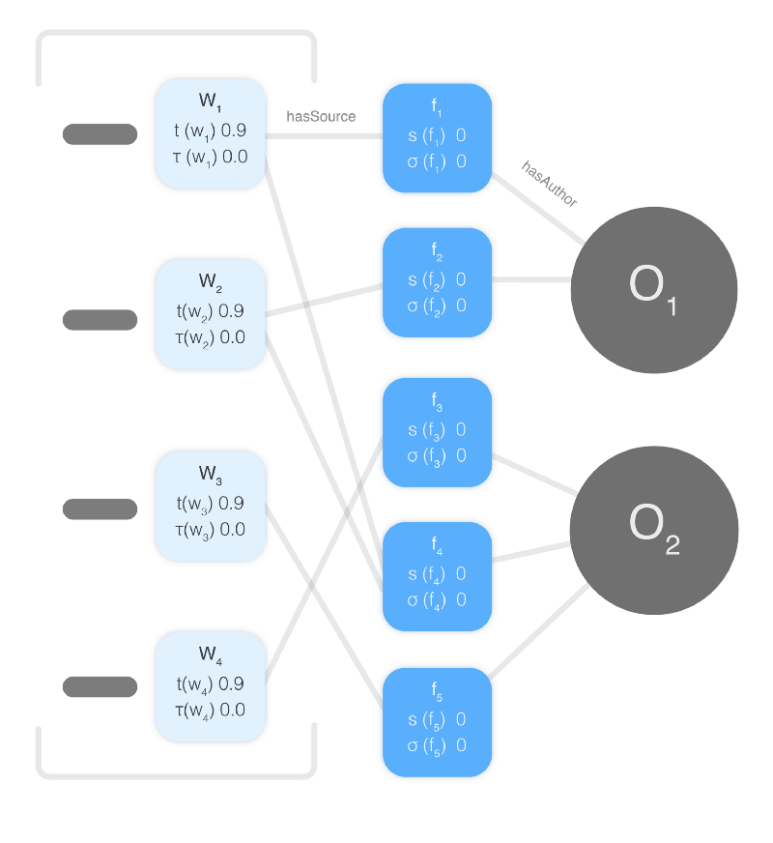
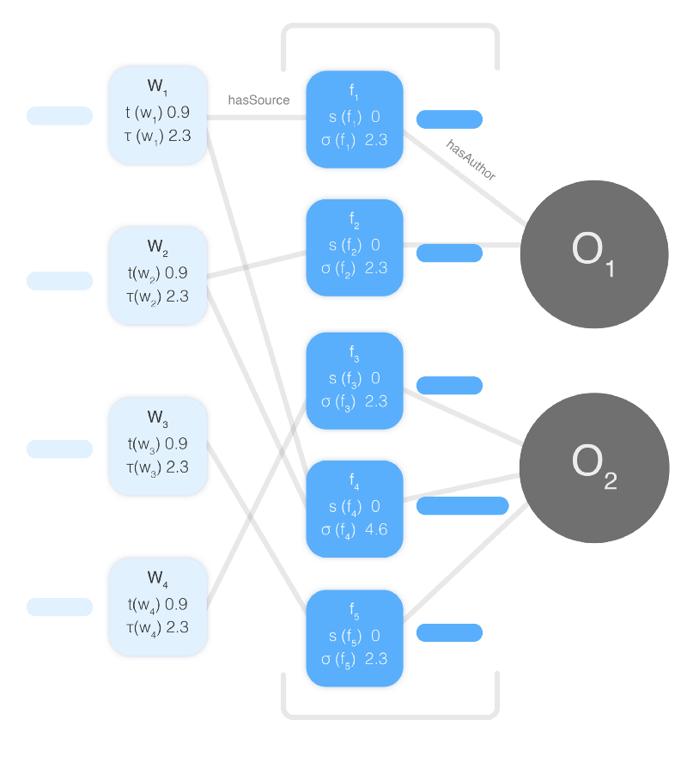
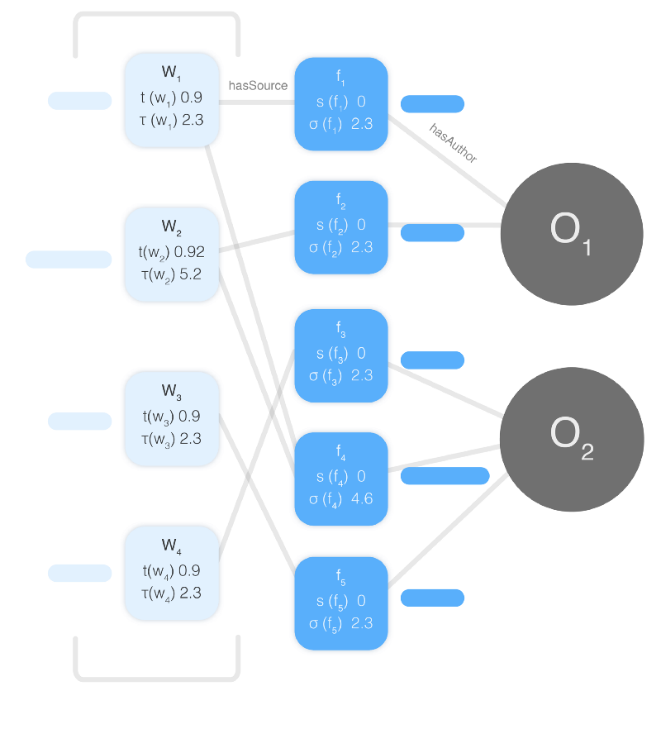
Truth discovery - iterative method Truthfinder
Iteratively
Compute truth estimation
Computer source reliability estimation
4. Iterate
1. Initialize source trust
2. Compute fact confidence
3. Compute source trust

Slide 58
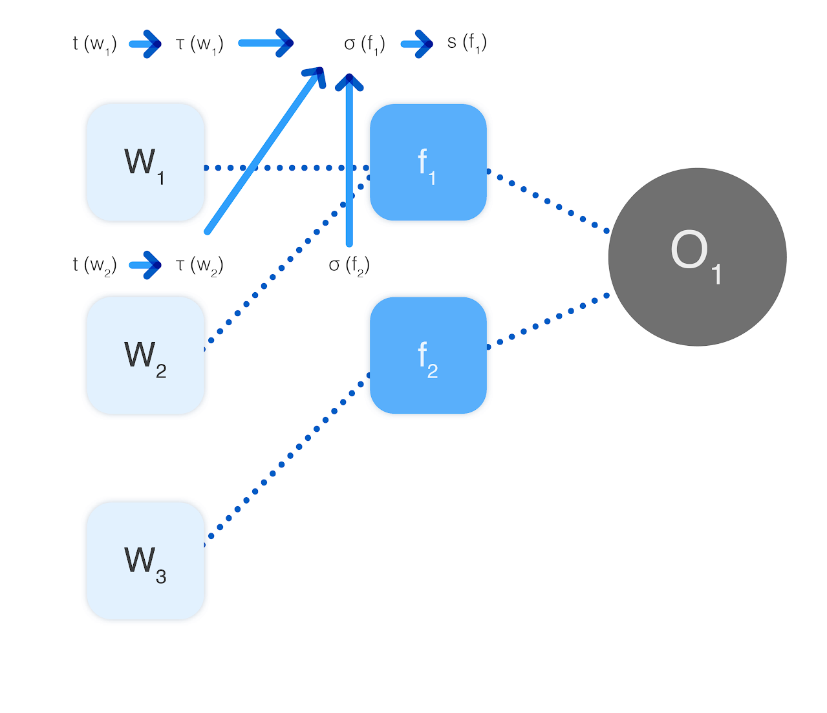
Truth discovery - iterative method Truthfinder
Advantages and results
Implemented in Gremlin, using graph queries
10% relative improvement compared to Majority voting
Scaling - distributed on a per entity basis
Claim similarity also affects score - domain specific eg. Jaro-Winkler

Slide 59
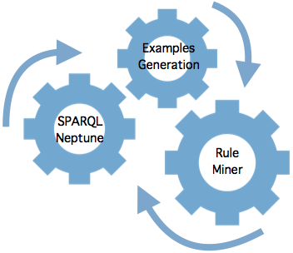

RuDiK: Fact Checking and Inference (Ontology Enrichment)
Knowledge Graph
RuDiK Inference Engine
Output Rules
Social
Company Sites
KB’s
child(x,y) → not spouse(x,y)
9k errors in Yago
News
SEC
KG
Press
Company DB
notableWork(y,x) → creator(x,y)
Influencer
138 new facts Wikidata
Jobs
Patents
ICDE’18
Feedback Loop
Human Validation
Notes:
Summary: How to learn inference rules and constraints from an existing KG that helps identify errors or infer new facts
Novelty is the ability to learn negative rules/constraints
Uses probabilistic mining to find “common” patterns that are violated by small number of cases -> constraints
Found problems in Wikidata where supposedly every fact is approved by multiple humans
Collaboration with Wikidata and Google KG being looked into
Problem: Rule mining from KG.
Has been looked at before, but RuDiK can mine
both positive (inferring new facts) and
negative rules (identifying errors, essentially constraints
Input: Just a KG.
Output: Set of rules/constraints that are learned from the current KG.
Identify uncommon (outlier-like) patterns, e.g., like the first rule … most children are not spouses, but the KG has some examples
→ constraint with violations
Rules are human readable and thus can be easily modified
Fun fact: Identified 138 new facts and about 300 errors in Wikidata.
Much less than in Yago/DBPedia
But every fact should be human checked
Wikidata guys were not happy at all about these numbers :)

Slide 60









Search & analytics performed on trillions of documents
Main Serving layer
Additional Interfaces
Graph Reasoner
Audience look-alikes
Ranking
Graph
Convolution
clustering
Descriptive statistics
Search
Aggregation
Drilldowns
Histograms
Graph embedding
near dup detection
Rule mining
10X better performance for our workloads with billions of searches on a petabyte scale index
Hybrid Inference
Bayesian Modeling
Pagerank
Heuristic query rewriting
Two phase query execution
Change/enhance es and lucene caching behavior
Distribute shards based on custom hotness model
Predictive search routing
Adaptive load balancing relative to query distribution
Shard placement using linear optimization

Slide 61
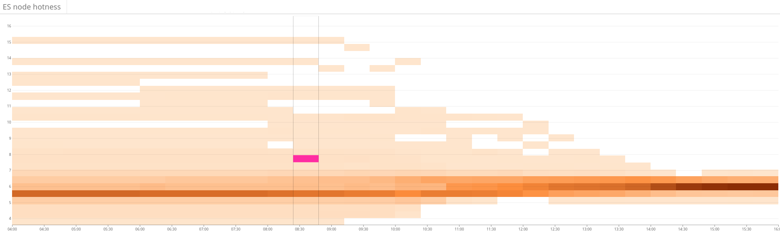
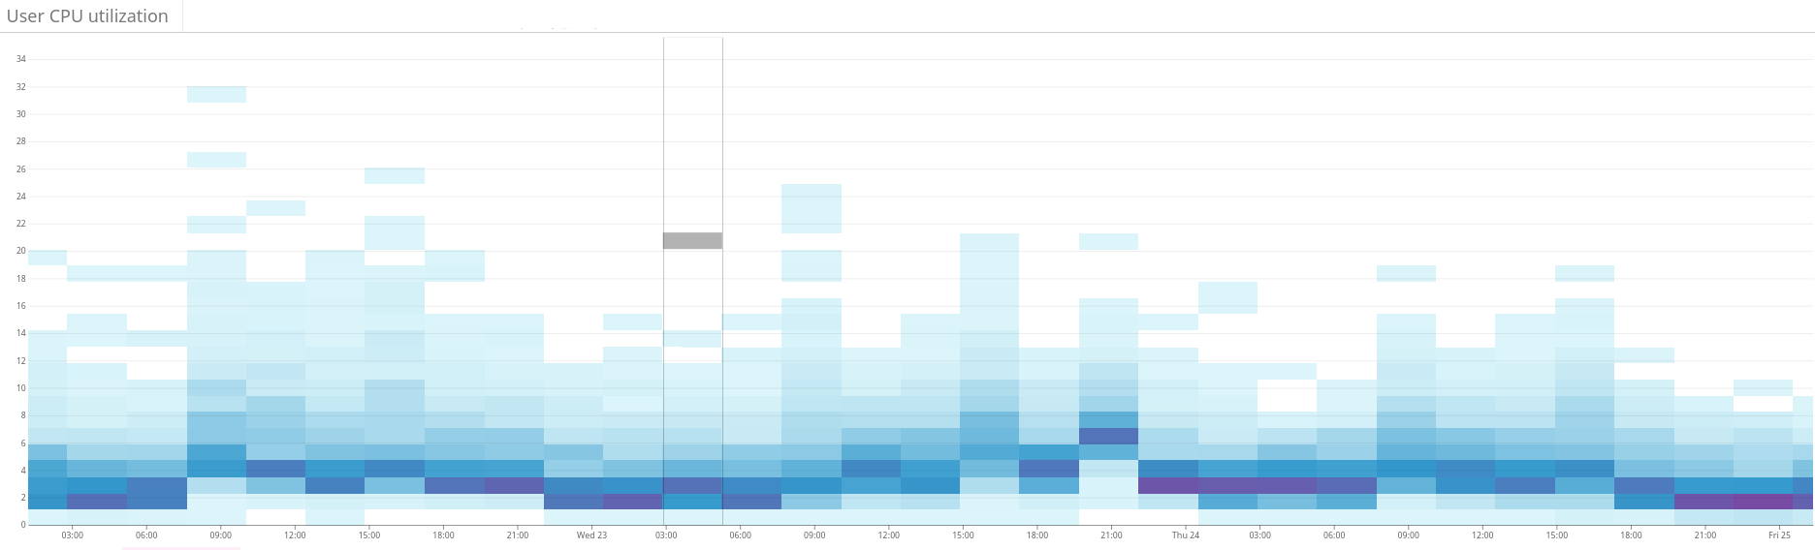
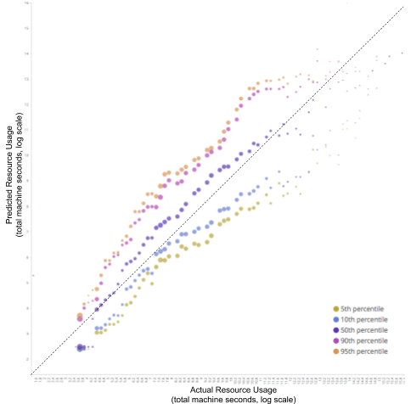
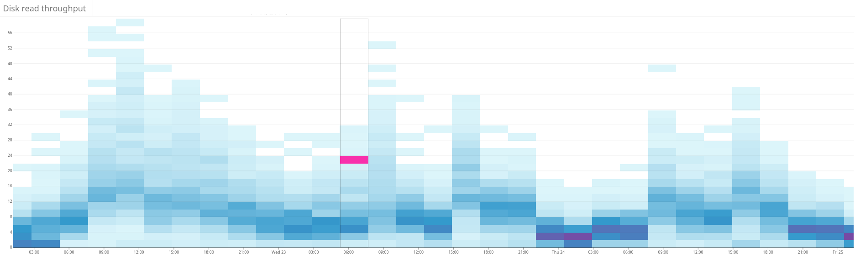
Machine Learning for Shard Placement & Query routing

Slide 62


Transformative shift
Self serve setup
Minimal adjustment of queries
Query expansion
Much faster & cheaper execution
Easier intent mining
Personalize the enrichments faster
Notes:
Adtitya

Slide 63

Unlock additional Meaning with Enrichment Services ii (Alpha)
Custom Models
Adapters for third party ML engines like Google AutoML & Amazon SageMaker to train your own models
Training dataset preparation using rule based searches & filters. Patented AI crawling for additional datasets
Manage Raw Data (Normalizing), Features (enrichments, filtering), model metrics, feedback data repository
Entity/Aspect resolution & disambiguation
Event & Relation extraction
Custom Sentiment
Classification (Auto tagging)

Slide 64




















Strong foundations in data science
Meltwater’s Fairhair team consists of:
81 engineers & data scientists
Graduates of Oxford, Stanford, CMU, Cambridge, UC Berkeley & more
Experience leading high profile projects at Yahoo, Netflix, Walmart, MongoDB, Redhat & more
Significant open source contributions

Slide 65

Questions
https://fairhair.ai/
http://meltwater.com

